Slide 1
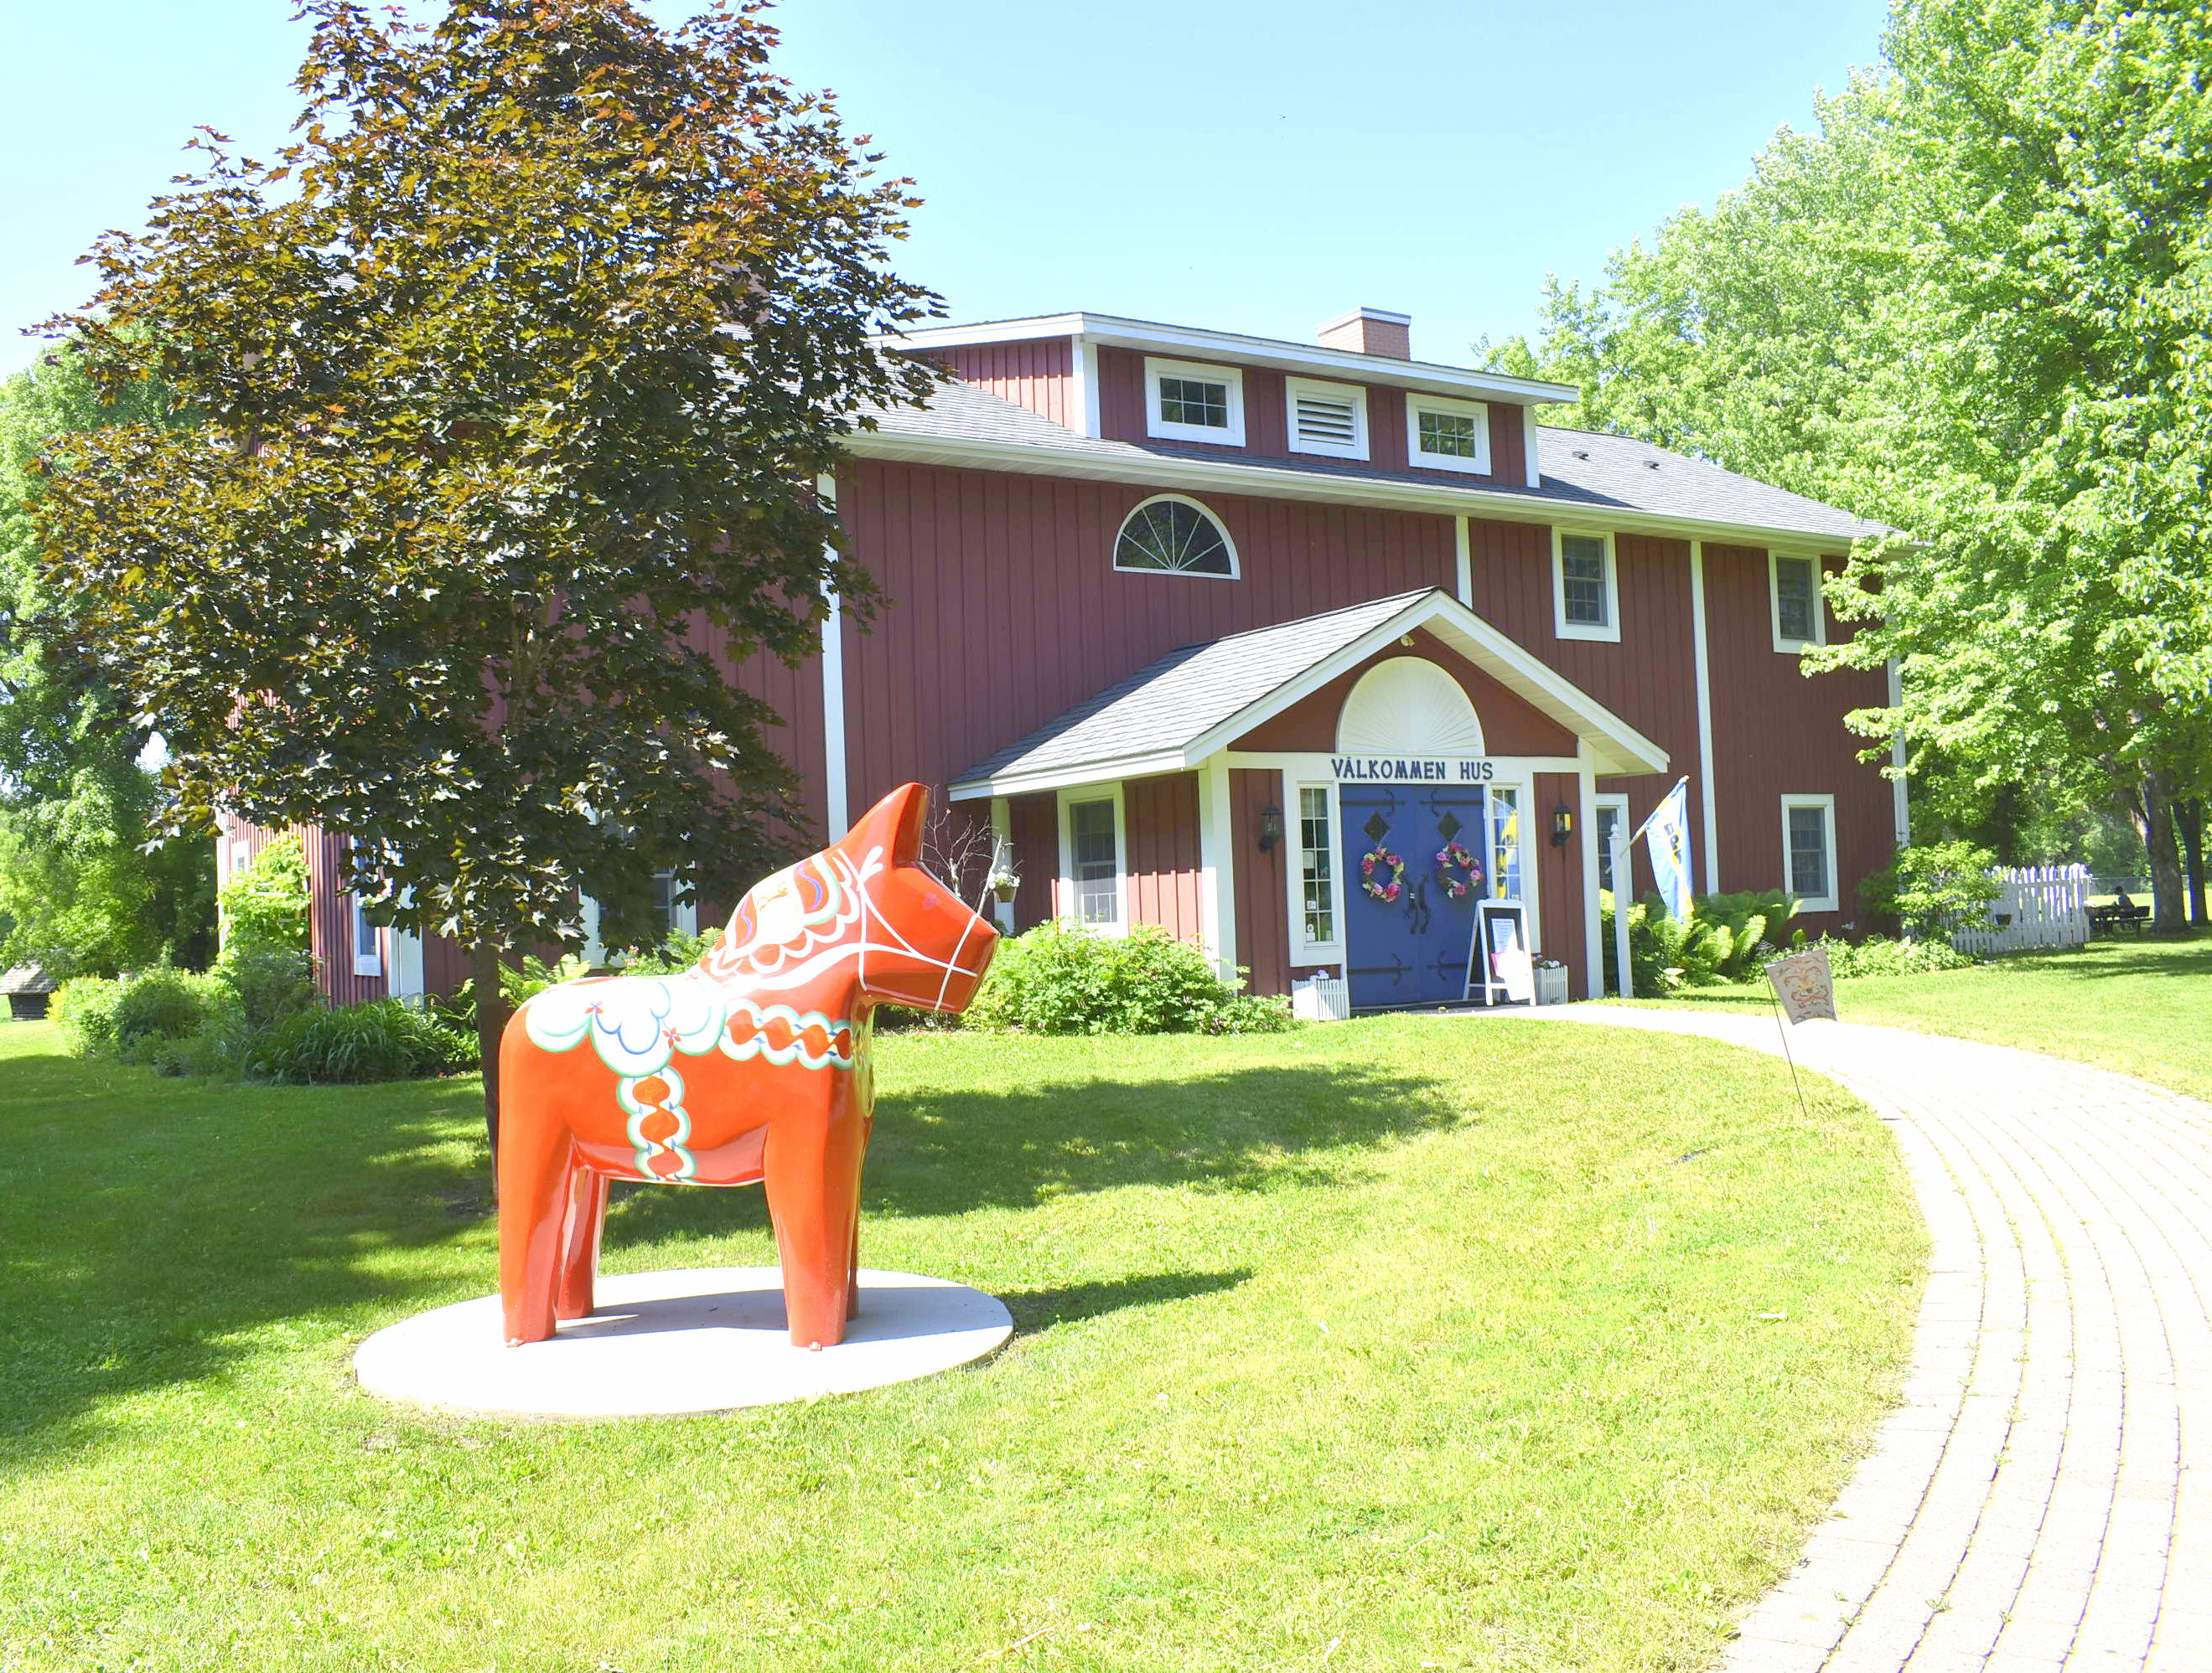
A Trip to Gammelgården Museum of Scandia
A Social Narrative Developed in collaboration with the Autism Society of Minnesota.

Slide 2
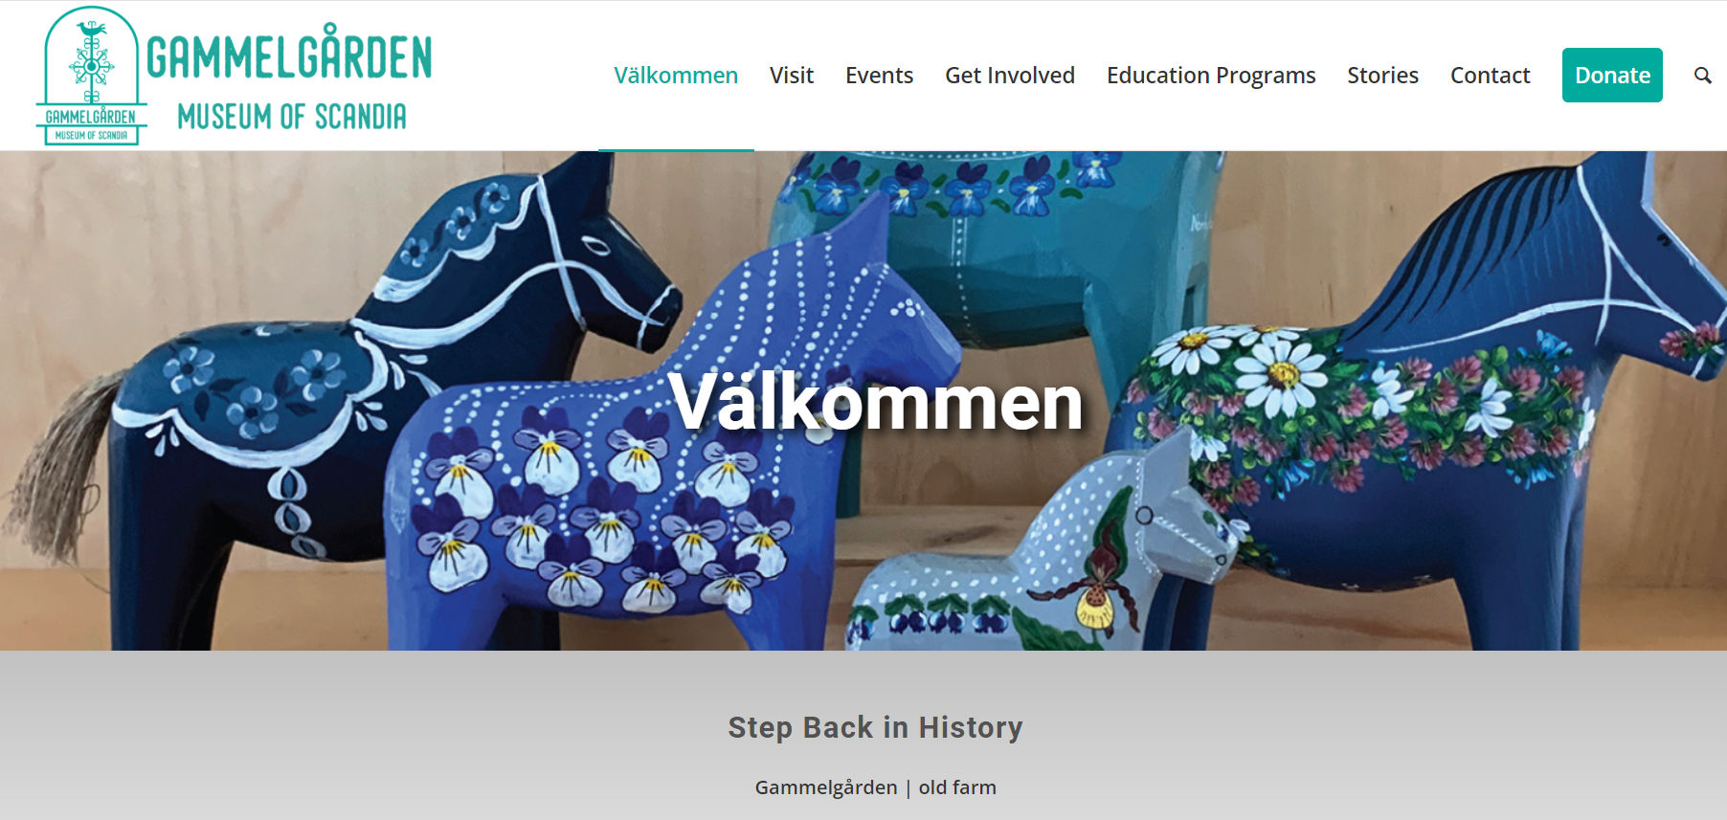
Tickets
Before I go, I can check Gammelgården’s website at www.gammelgardenmuseum.org for more information.
I can call the museum if I have specific questions at this number: 651-433-5053.
It is free to walk the museum grounds and see the exhibits in the Welcome Center (Välkommen Hus - the big red building). For a walk-in tour, there may be a fee for some visitors.
I can check the website or call ahead to determine the cost of a tour or program, and if tickets need to be purchased in advance.
I will bring a printed copy of my ticket or the electronic ticket from my email/app.

Slide 3
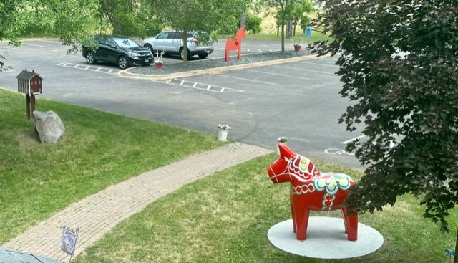
Transportation
I am going to Gammelgården Museum at 20880 Olinda Trail North in Scandia.
Before I go, I can look up driving directions on my phone or online.
Gammelgården Museum offers free parking. If the lot is full, I can park on Olinda Trail, on 209th Street, at Elim Lutheran Church, or at the Scandia Community Center.

Slide 4
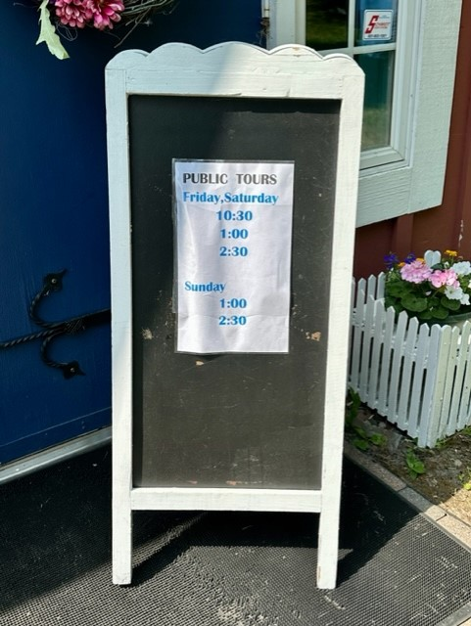
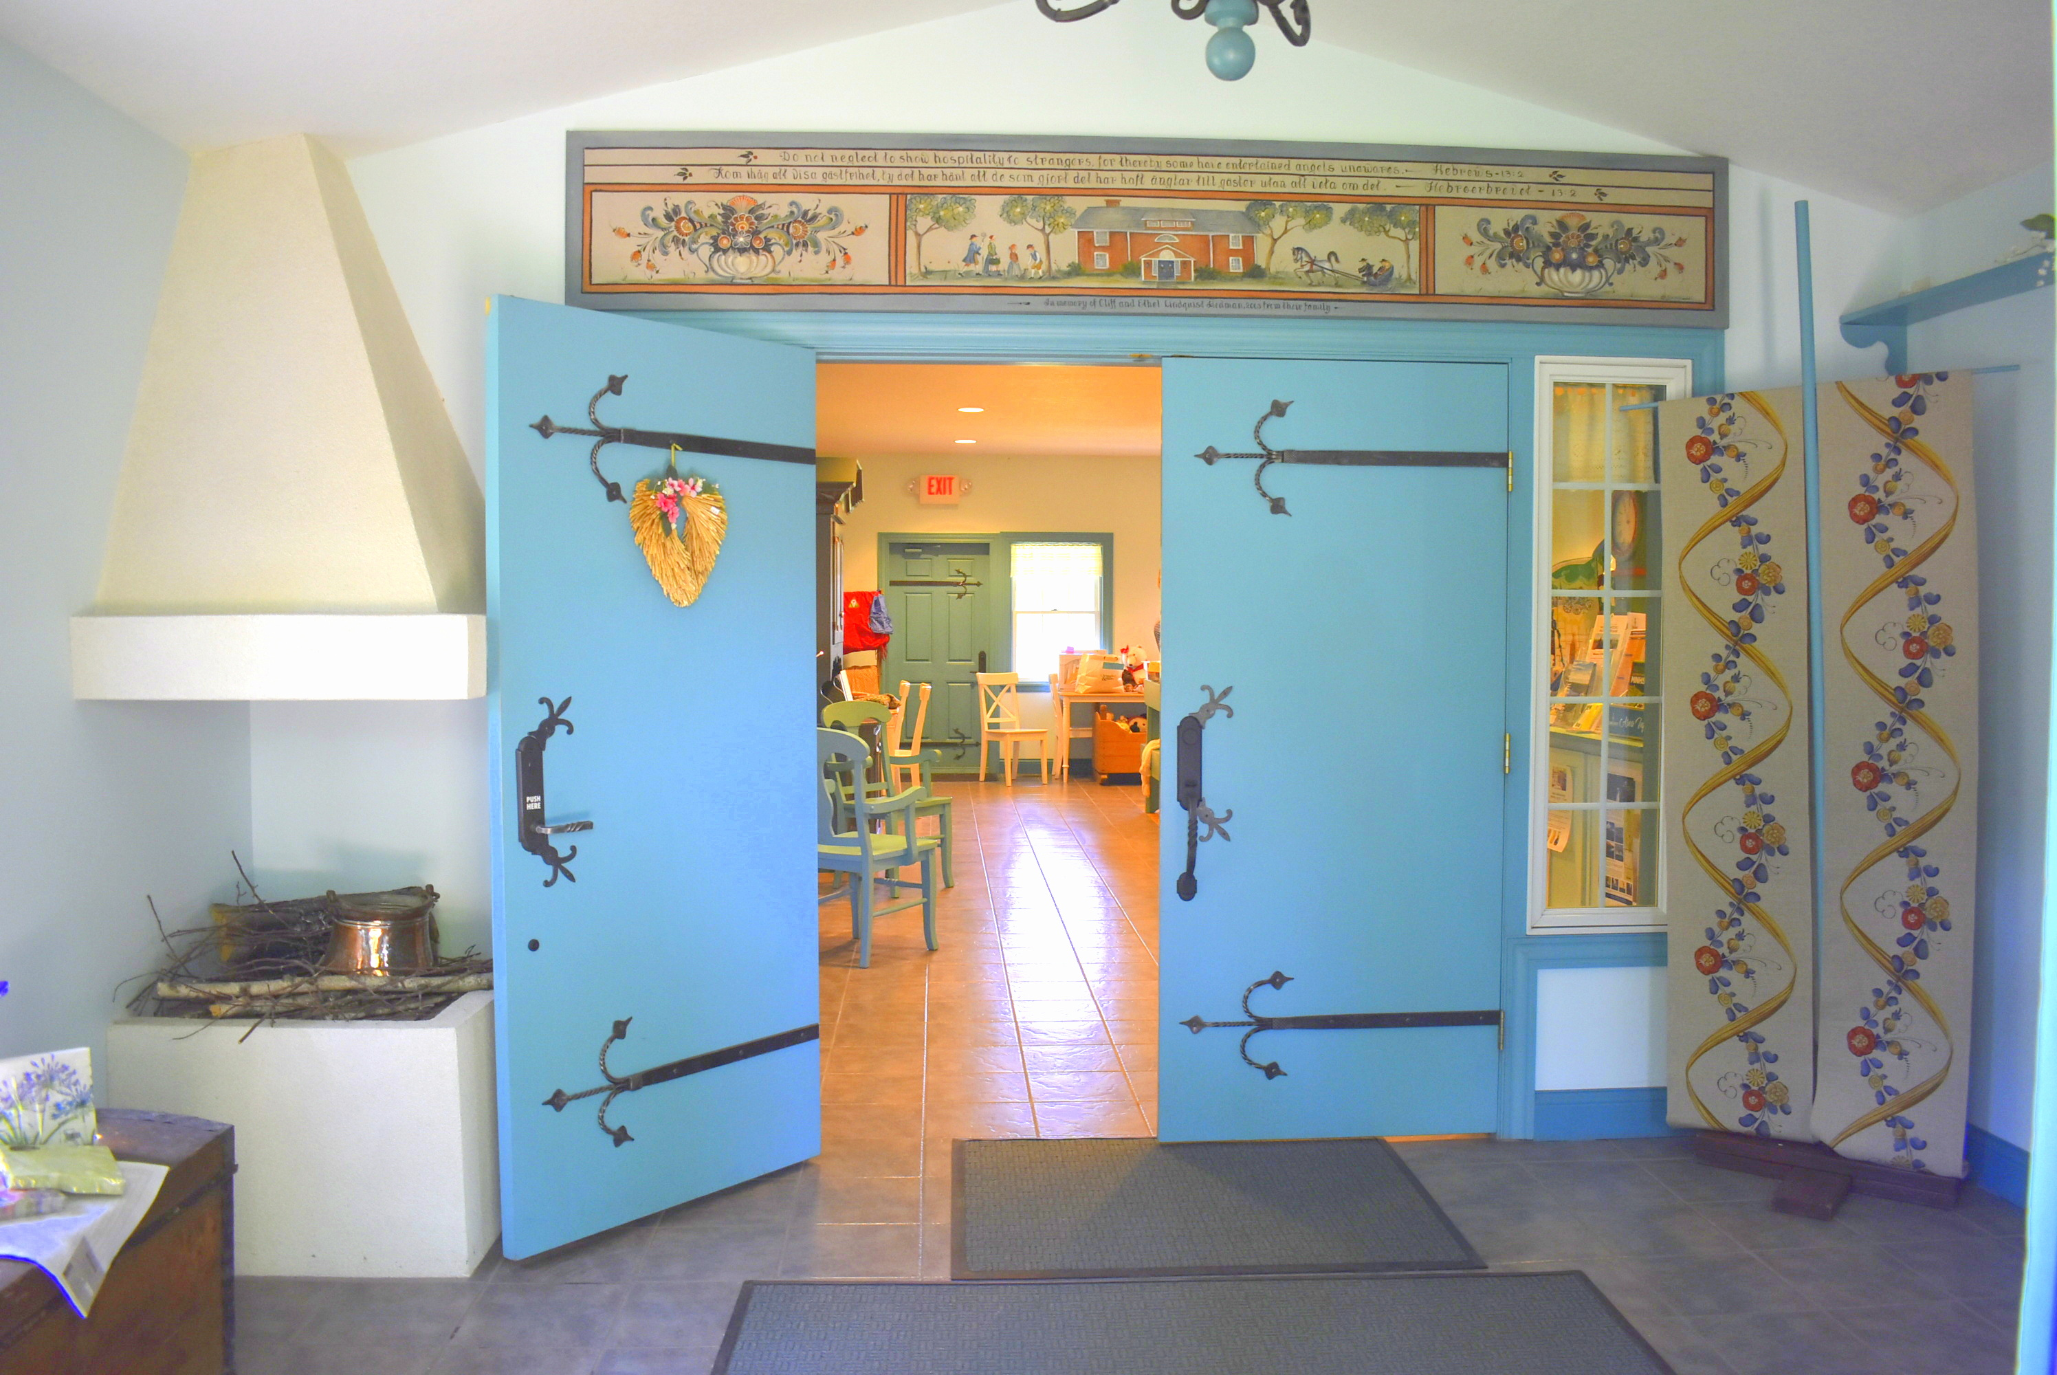
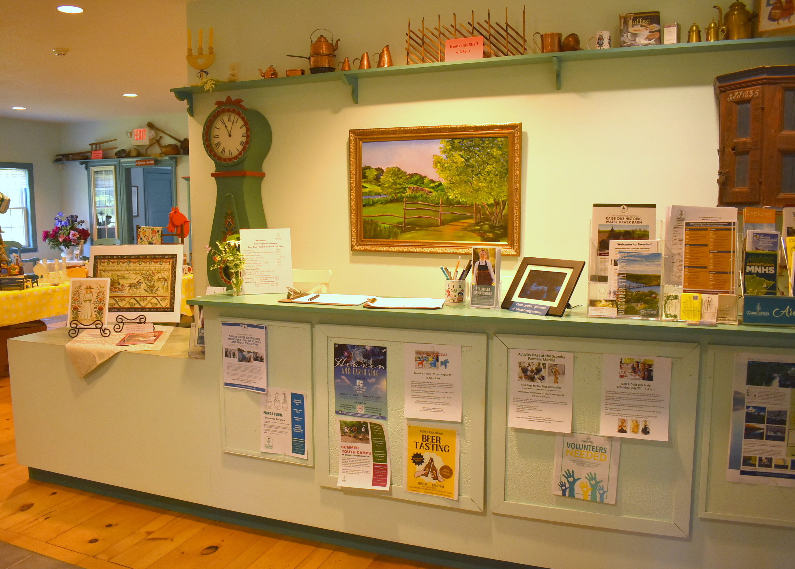
Museums and Tours
I enter the museum through the front doors of the big red building (Välkommen Hus).
If there are tours on the day I am visiting, there is a stand by the front door with the tour times.
The museum has free brochures with information about the museum and tours.
I can purchase tickets for a tour in the Butik (gift shop).
If I bought tickets in advance, I bring the printed copy or pull up the electronic ticket from my email.

Slide 5
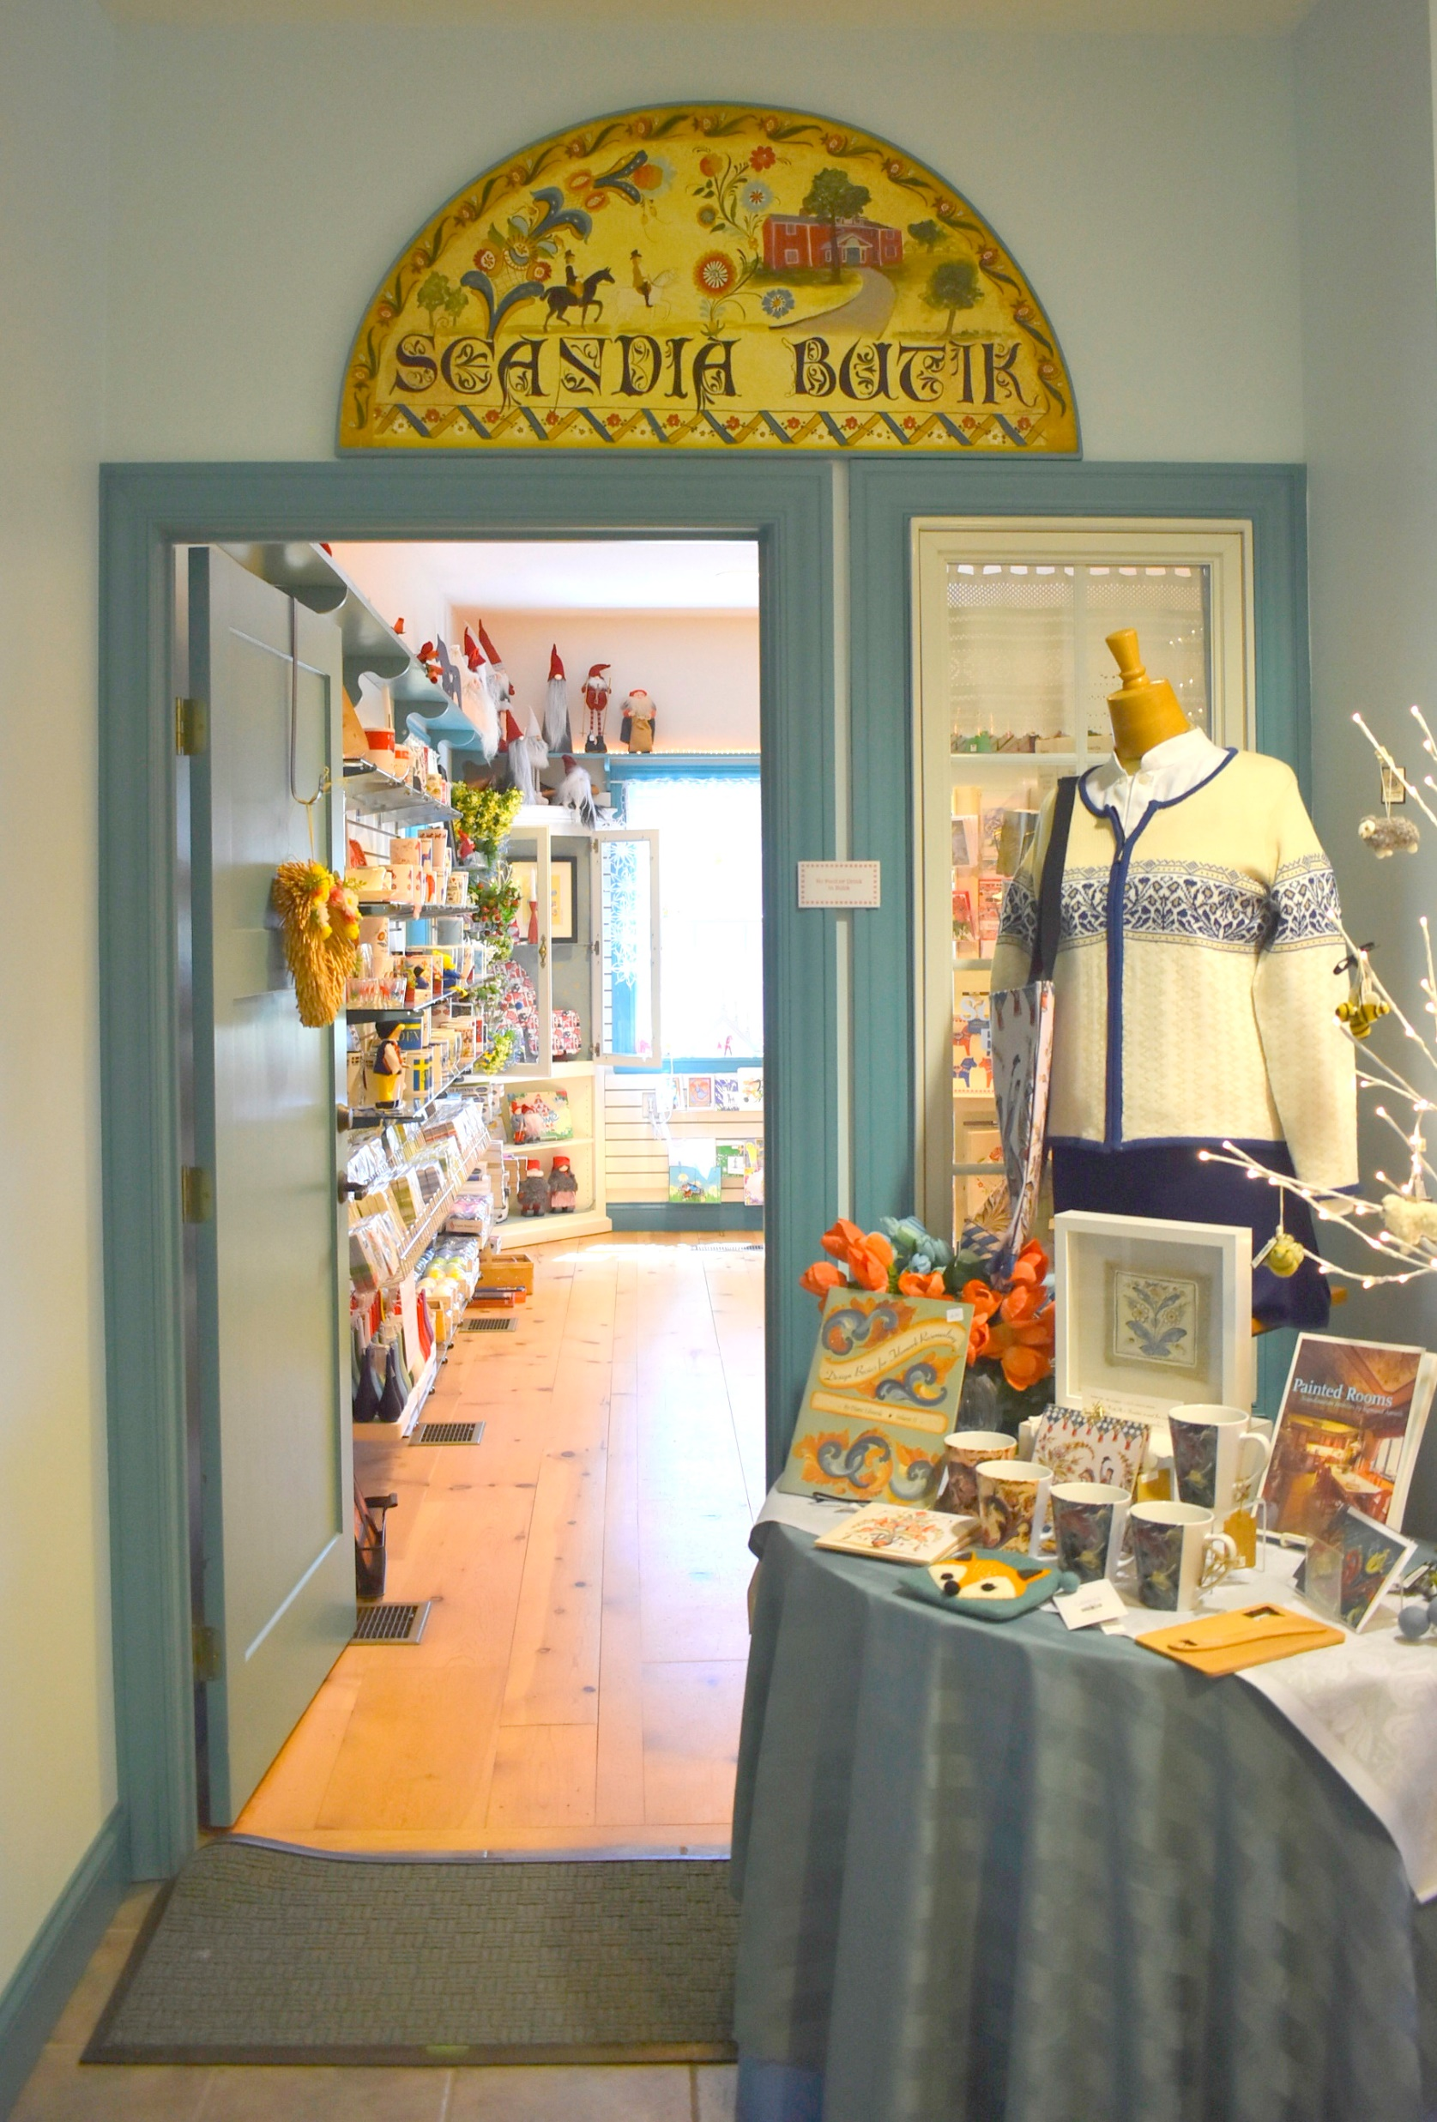
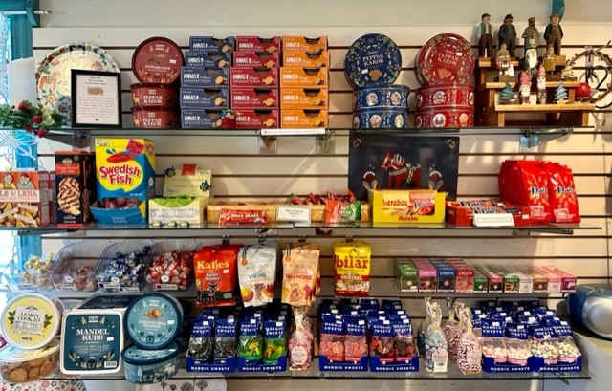
Food and Snacks
Food and drinks are not allowed in the museum’s historic buildings. This is to preserve the historic relics.
If I need a snack, I can purchase it at the Museum’s Butik (gift shop) which is across from the front desk.
I may eat my snack in the first-floor gathering area of the Välkommen Hus or outdoors.

Slide 6
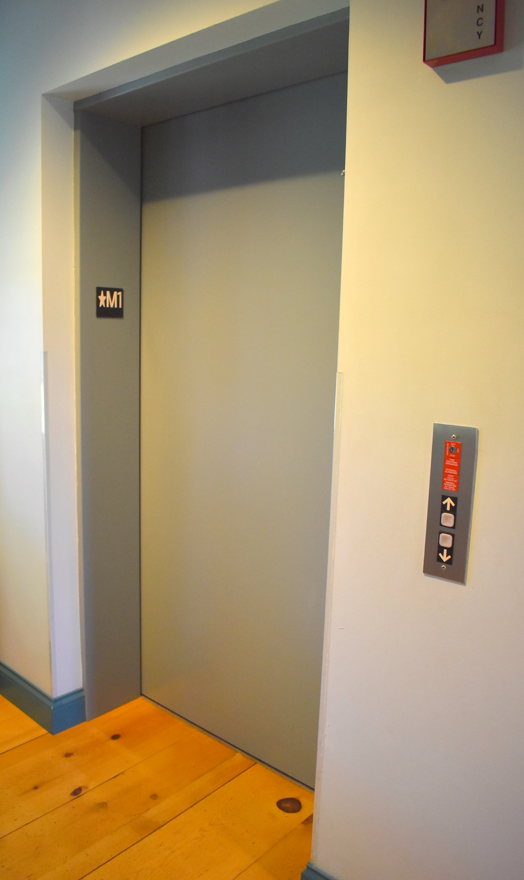
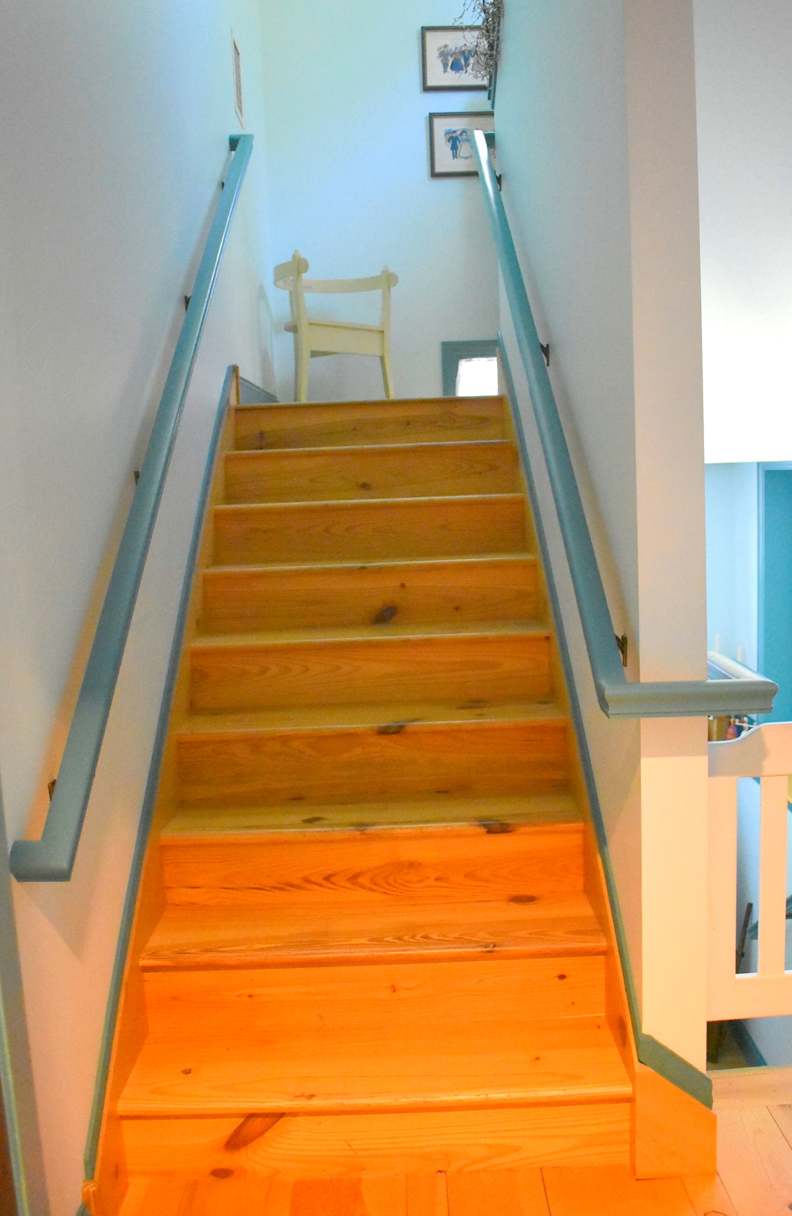
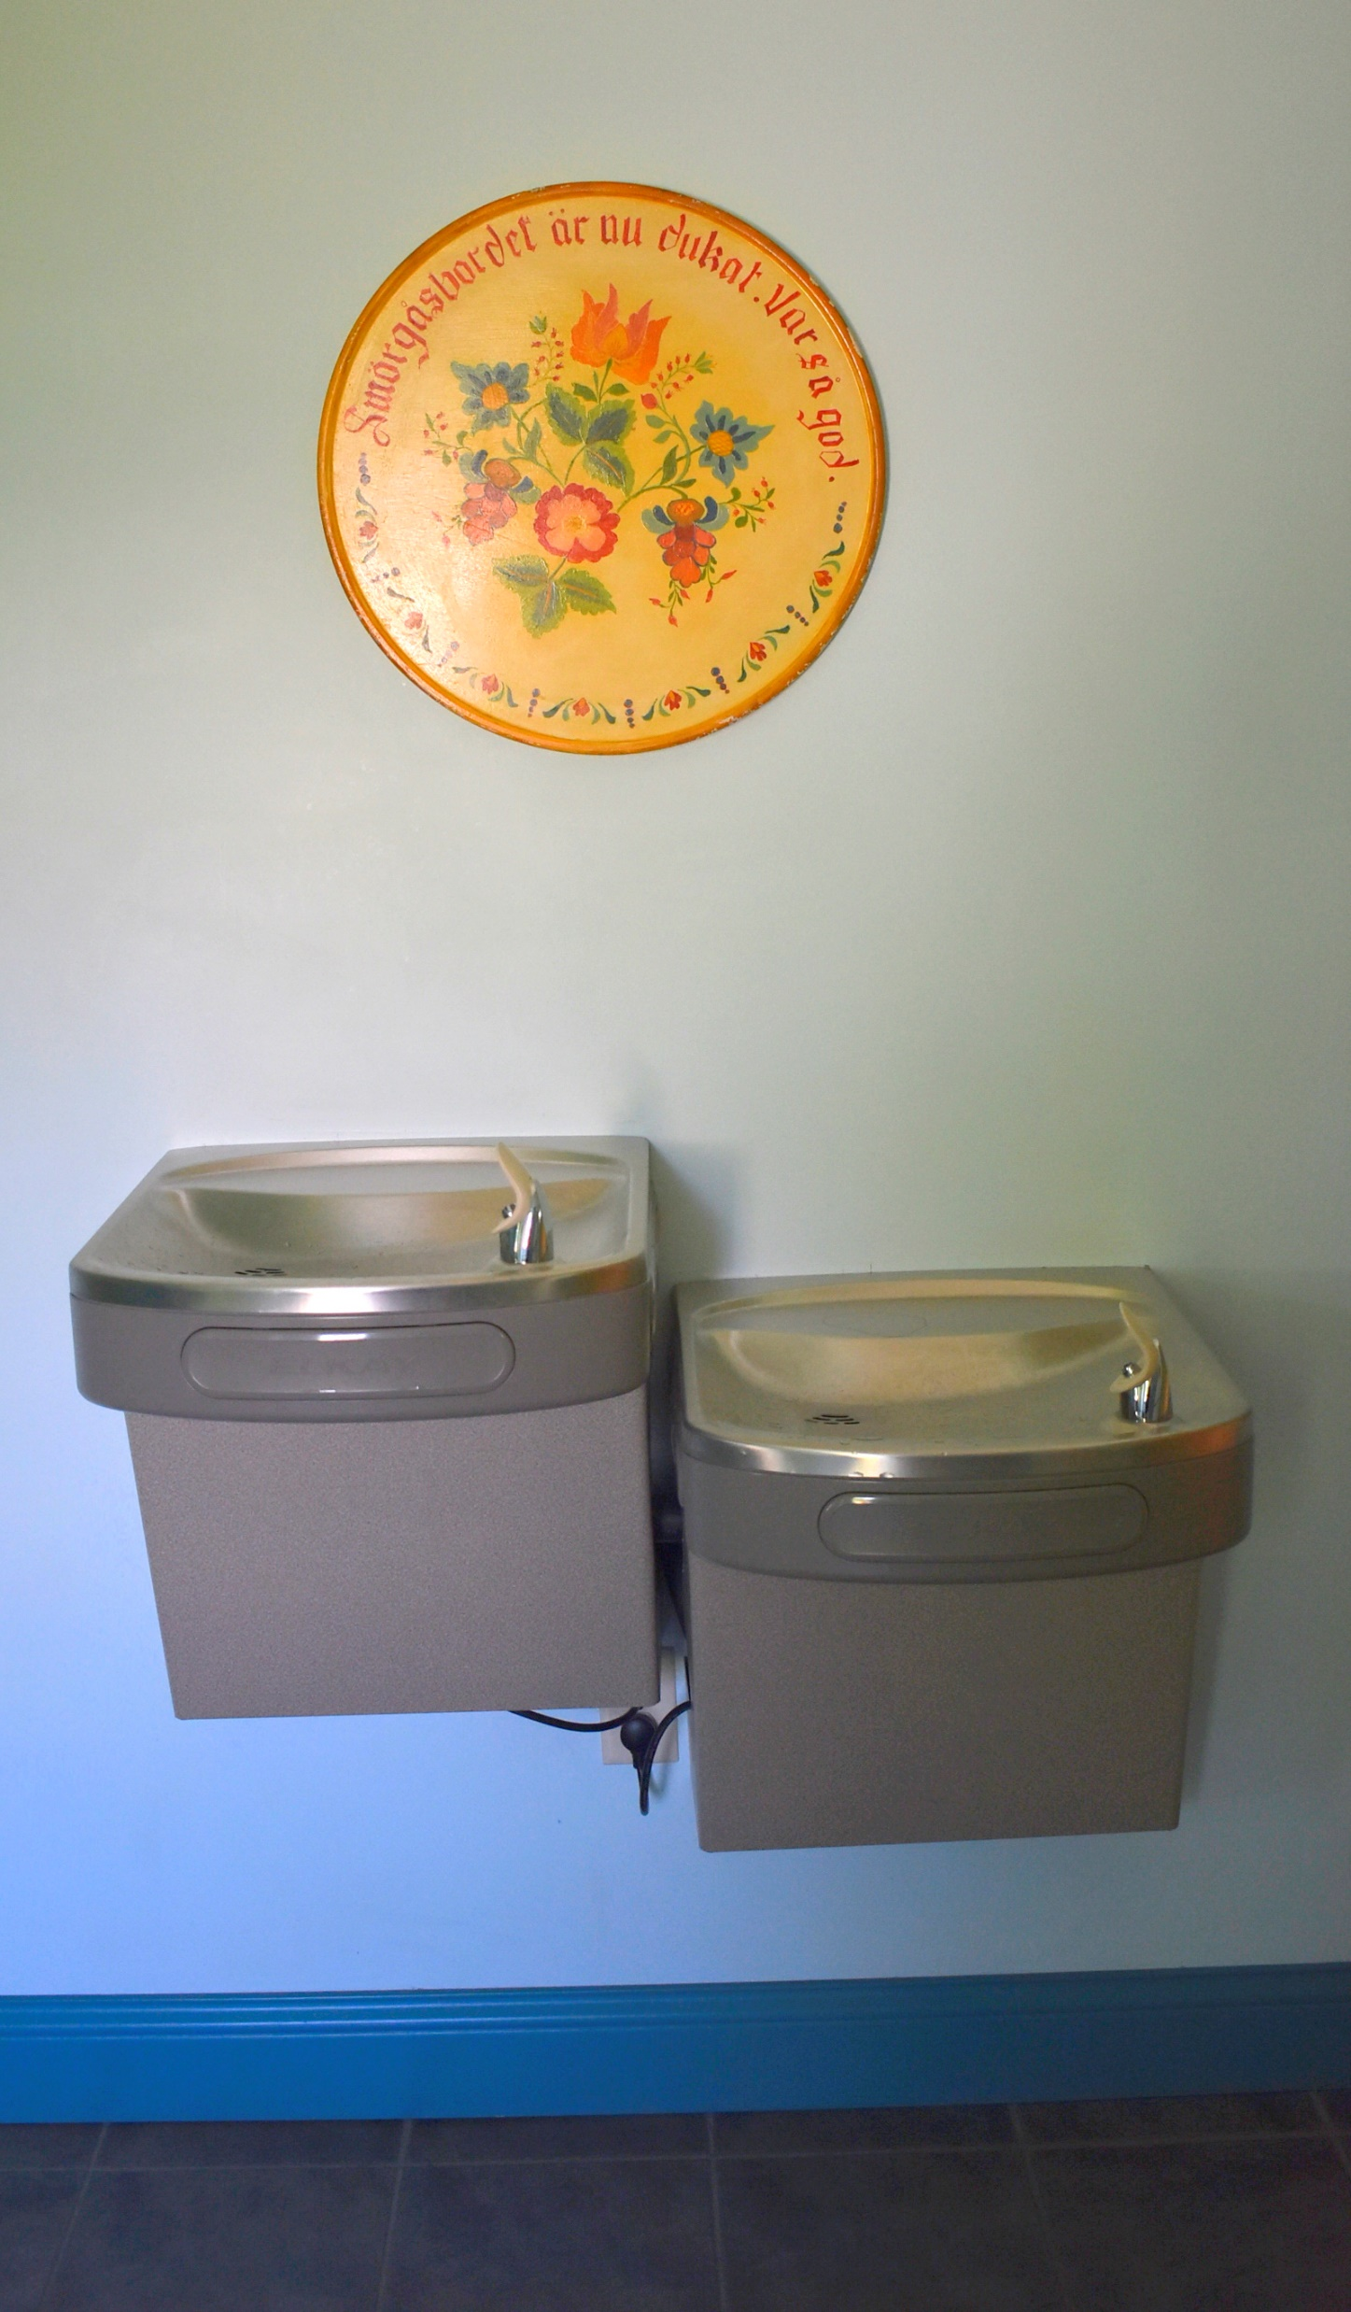
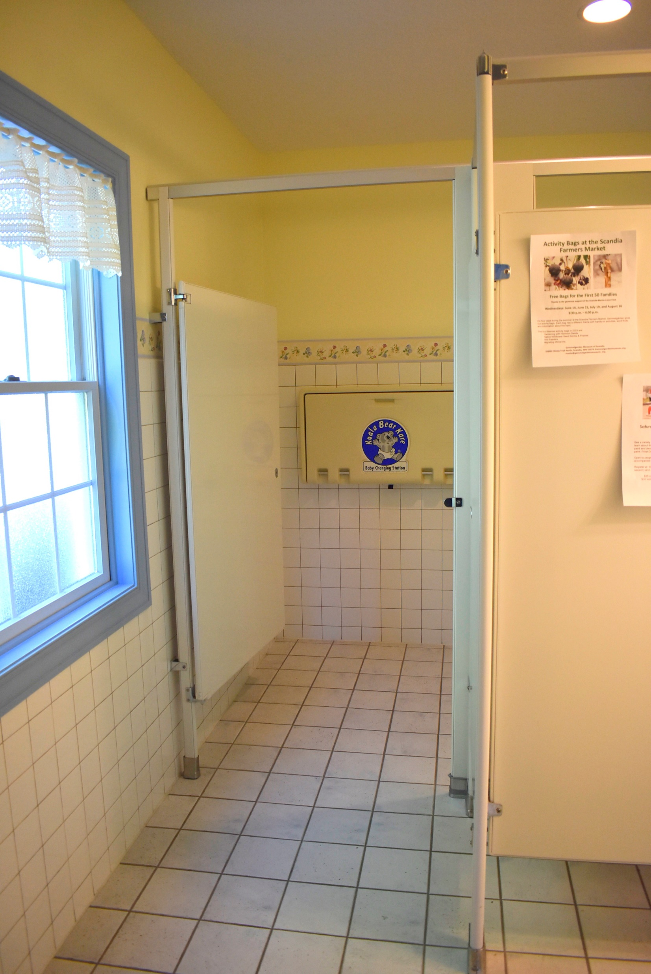
Accessibility (1)
I can use the elevator in the main building (Välkommen Hus) if I am not able to use the stairs.
I can use the drinking fountains available by the first-floor bathrooms.
I can use the bathrooms on the first and second floor of the main building.

Slide 7
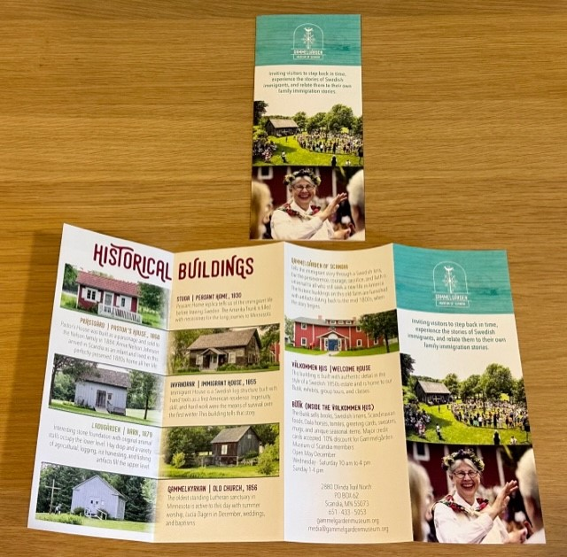
Accessibility (2)
I may take one of Gammelgården’s printed brochures that show pictures and short descriptions of the historic buildings.
I can look at Gammelgården’s website which has online art exhibits featuring images of the artwork and artists’ statements about each one.

Slide 8
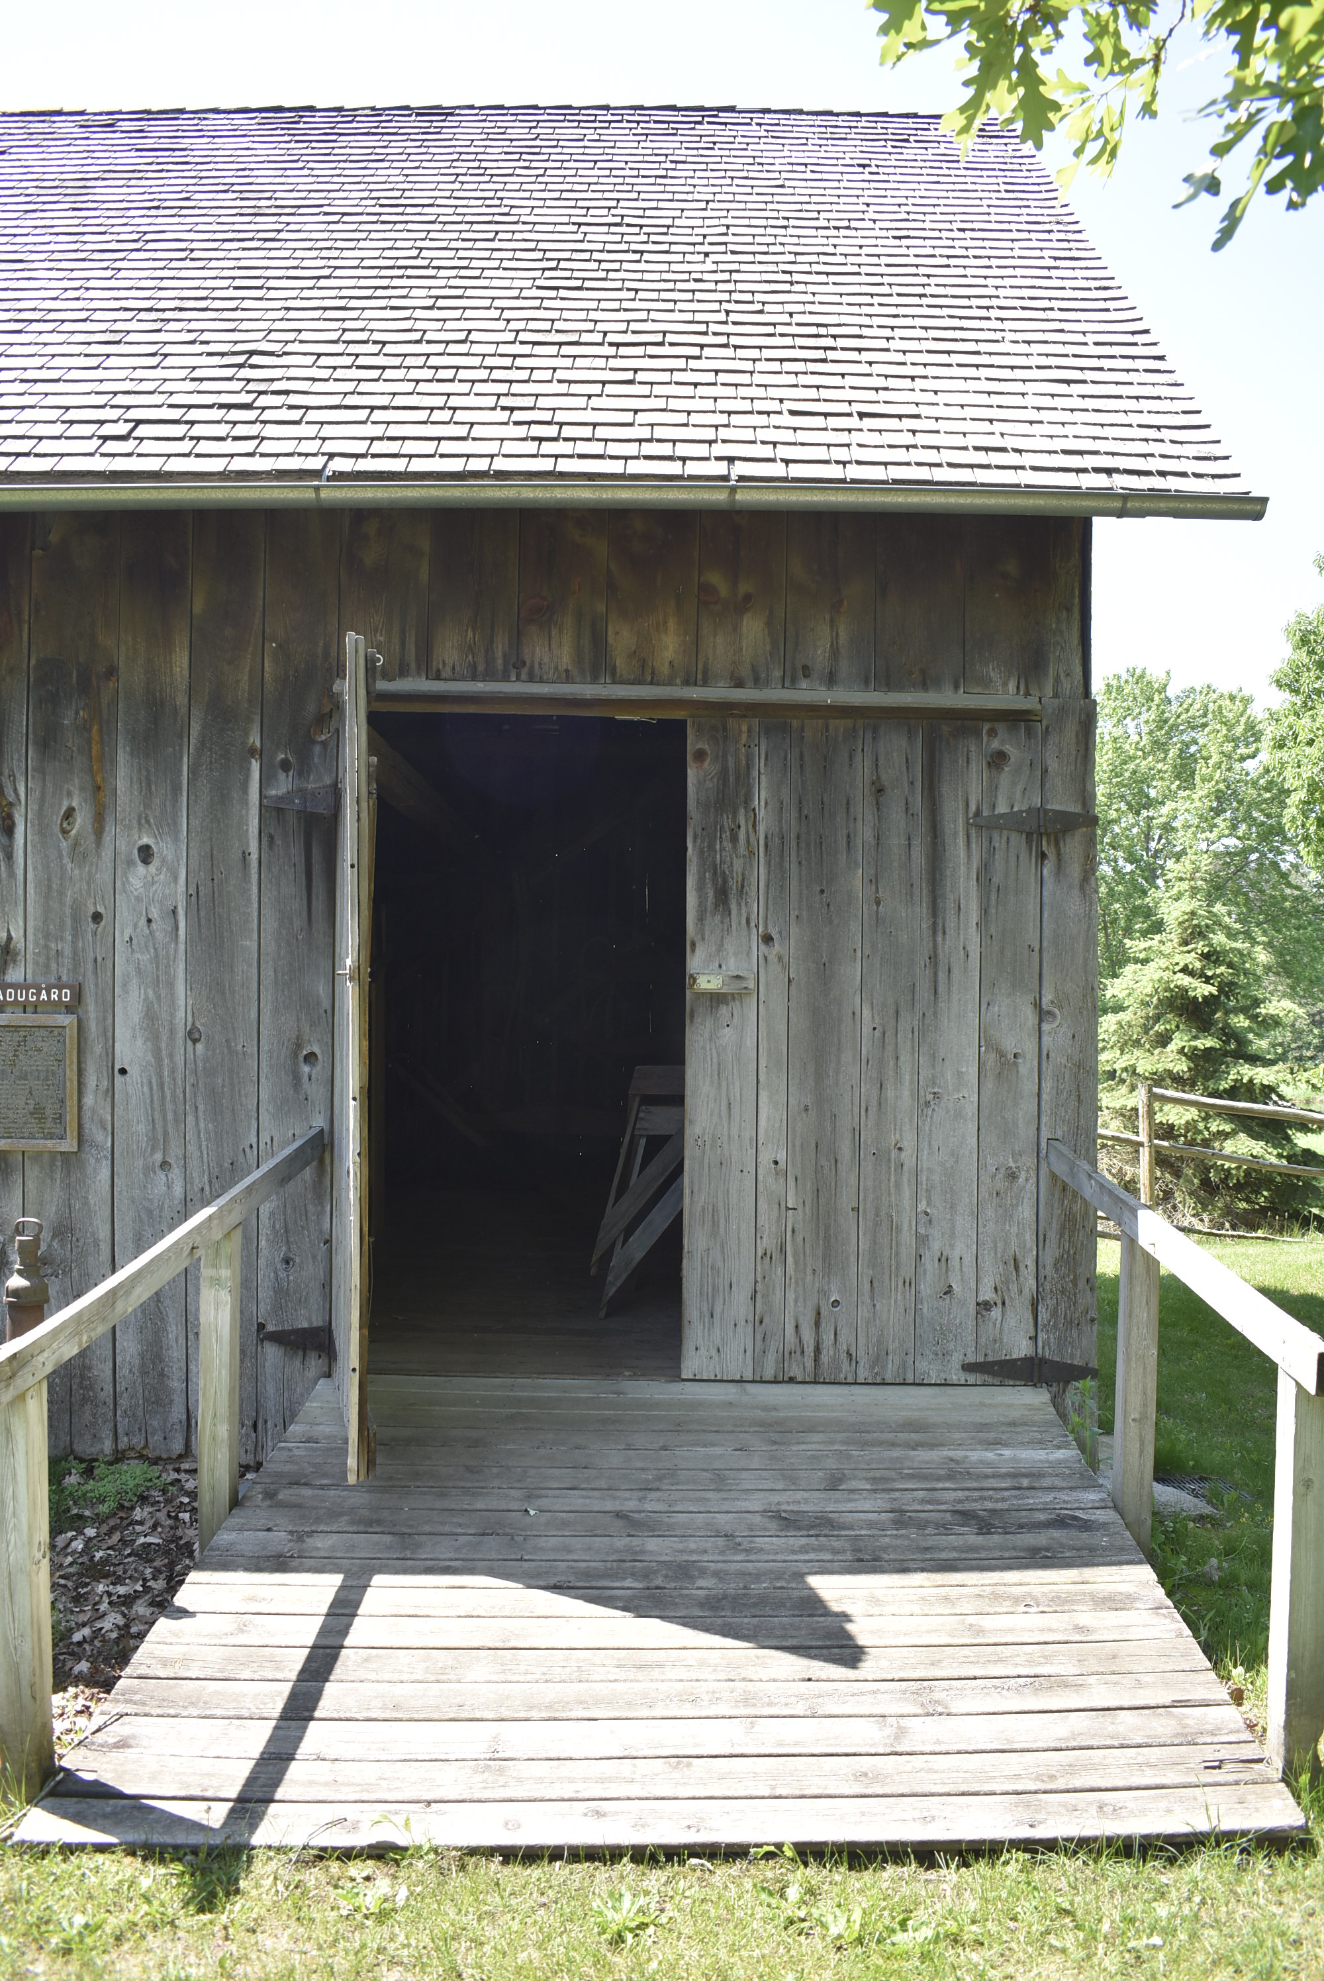
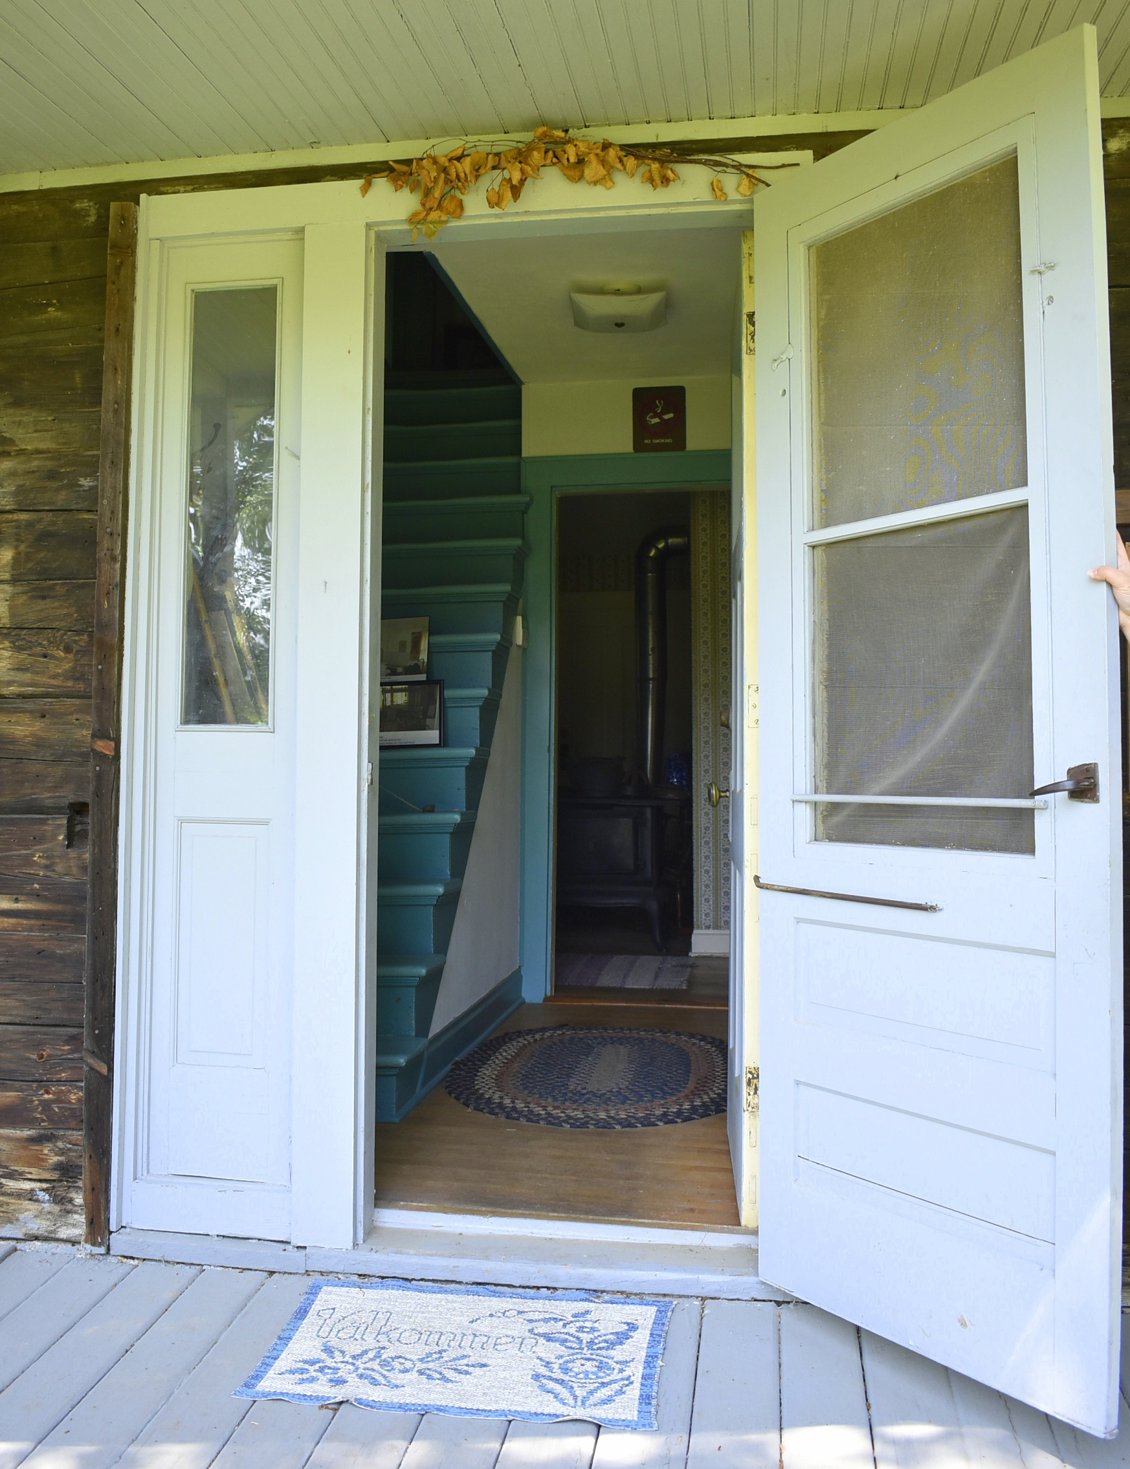
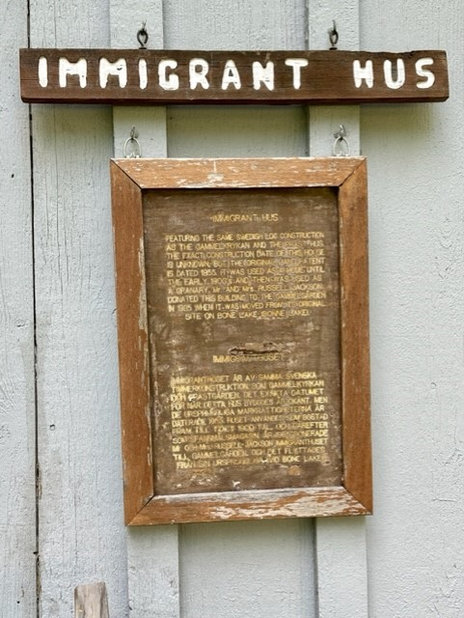
Accessibility (3)
The historic buildings have ramps. I notice that some of the historic buildings have steep ramps leading to the buildings.
I notice that signs describing the historic buildings are placed near the building entrances.
Gammelgården is dedicated to accessibility and updating its building to meet ADA and accessible standards for guests.

Slide 9
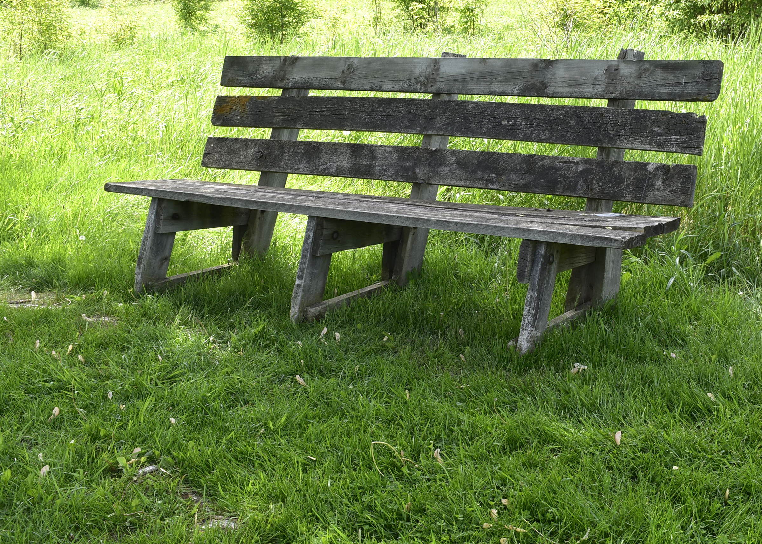
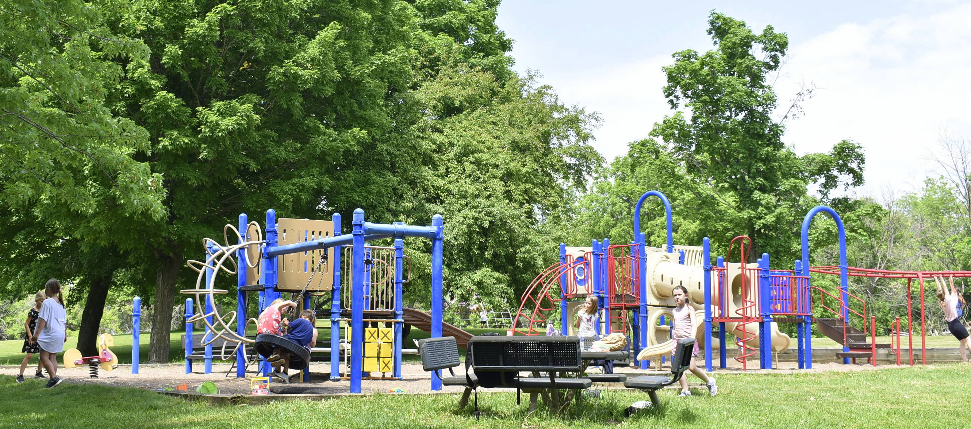
Sensory Needs
If I am feeling overwhelmed, I can go to an area away from my group – either indoors or outdoors. Indoors, I can ask a staff member where I can take a break. Outside, there are benches and a playground.
If I go outside, I will check with a staff member to make sure I can get back inside.
I can always come back to the group when I am ready.

Slide 10
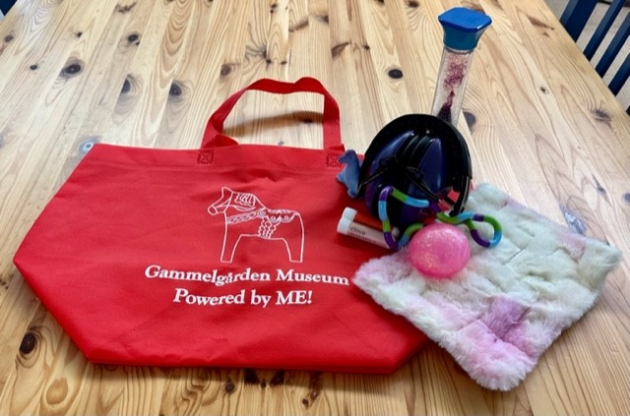
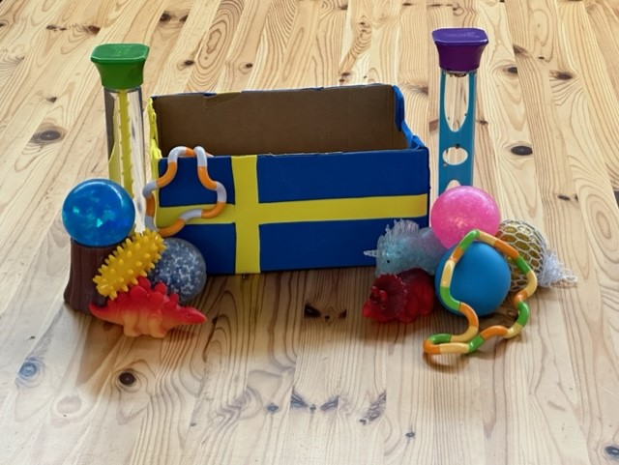
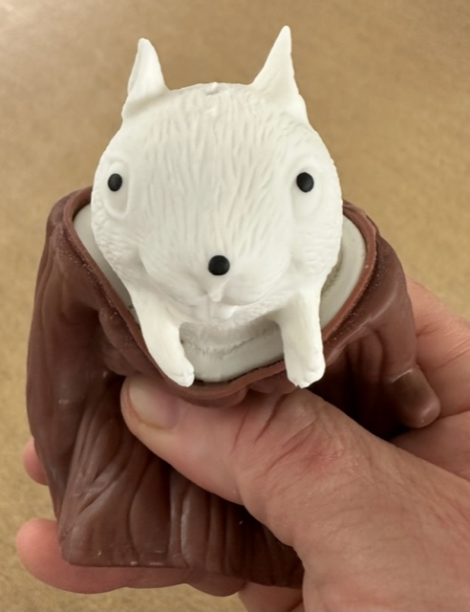
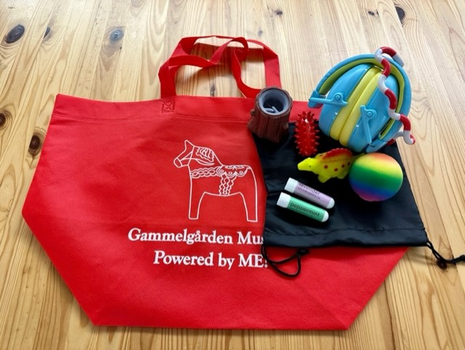
Sensory Tools
I can bring my own sensory tools (e.g., fidgets, headphones, visuals) to use at the museum.
I may bring sensory snacks if the location at the museum allows food and drink.
I can ask a staff member if they have sensory tools available to borrow.
I may need to provide my information such as my name, phone number, ID, or credit/debit card to reserve the tools.
I need to return these tools to a staff member before I leave.

Slide 11
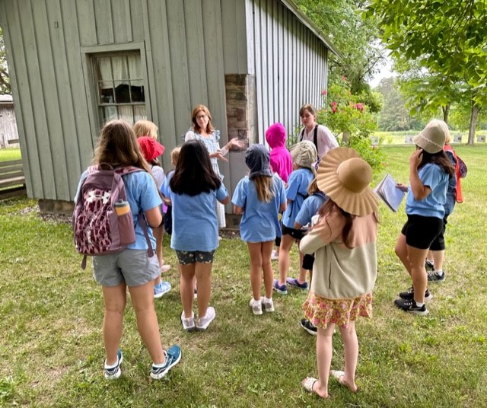
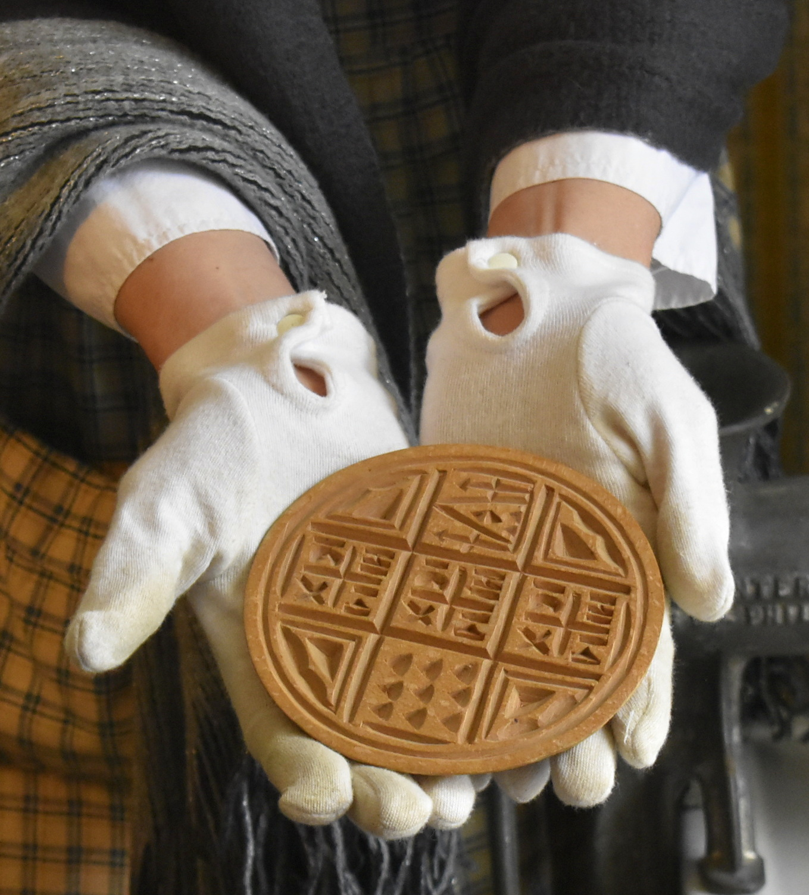
Museum Expectations
I remember to follow the rules at Gammelgården Museum:
I stay with my group while I explore the museum.
I walk when I am in the buildings.
I take turns with other visitors.
I use my indoor voice when I am in the historical buildings and exhibit areas.
I keep my hands to myself.
I am respectful of the outdoor museum property, keep my hands off of the bluebird houses, and use the trash and recycling cans if needed.
I stay out of the gardens so the plants can grow.
At Gammelgården Museum, the tour guides are the only ones who touch the artifacts. They wear white gloves if they touch an artifact so that the oils from their skin do not get onto it.

Slide 12
There are a lot of things to see and do at the Museum. My family and I can make a plan for our visit. We could even use a checklist to choose the things we want to do. I may not be able to do everything today. And, sometimes, buildings are closed. That is okay. I can do it another day. OUTSIDE AND HISTORIC BUILDINGS q See the 5 large Dala horses on the museum grounds. q Take a tour of the 5 historic buildings. q Relax by the restored prairie. q Walk on the bluebird trail. q Go on a scavenger hunt. See: https://gammelgardenmuseum.org/education-programs/#events-for-youth q See the heritage gardens. VALKOMMEN HUS q See the current art exhibit. q See the museum’s collection of over 150 Dala horses. q Do some stitching on the quilt on the quilting frame. q See the Scandia bicentennial quilt. q See examples of weaving that would have been done in the mid- to late-1800s. q Shop in the Butik (gift shop). q See the large Dala horse on the first floor. q Take a class or workshop; or attend a seasonal coffee party.
Things to Do at the Museum

Slide 13
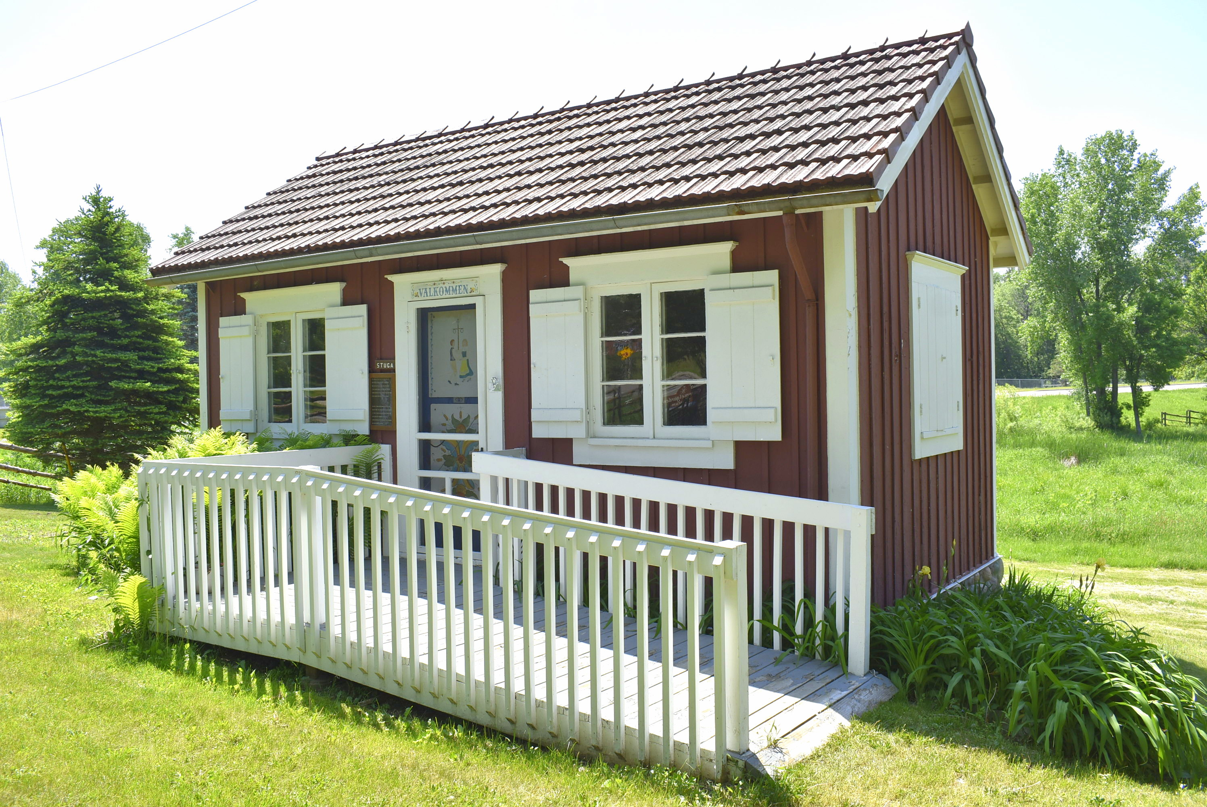
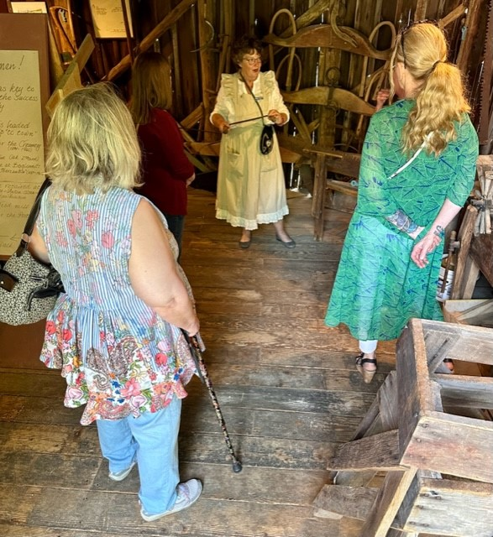
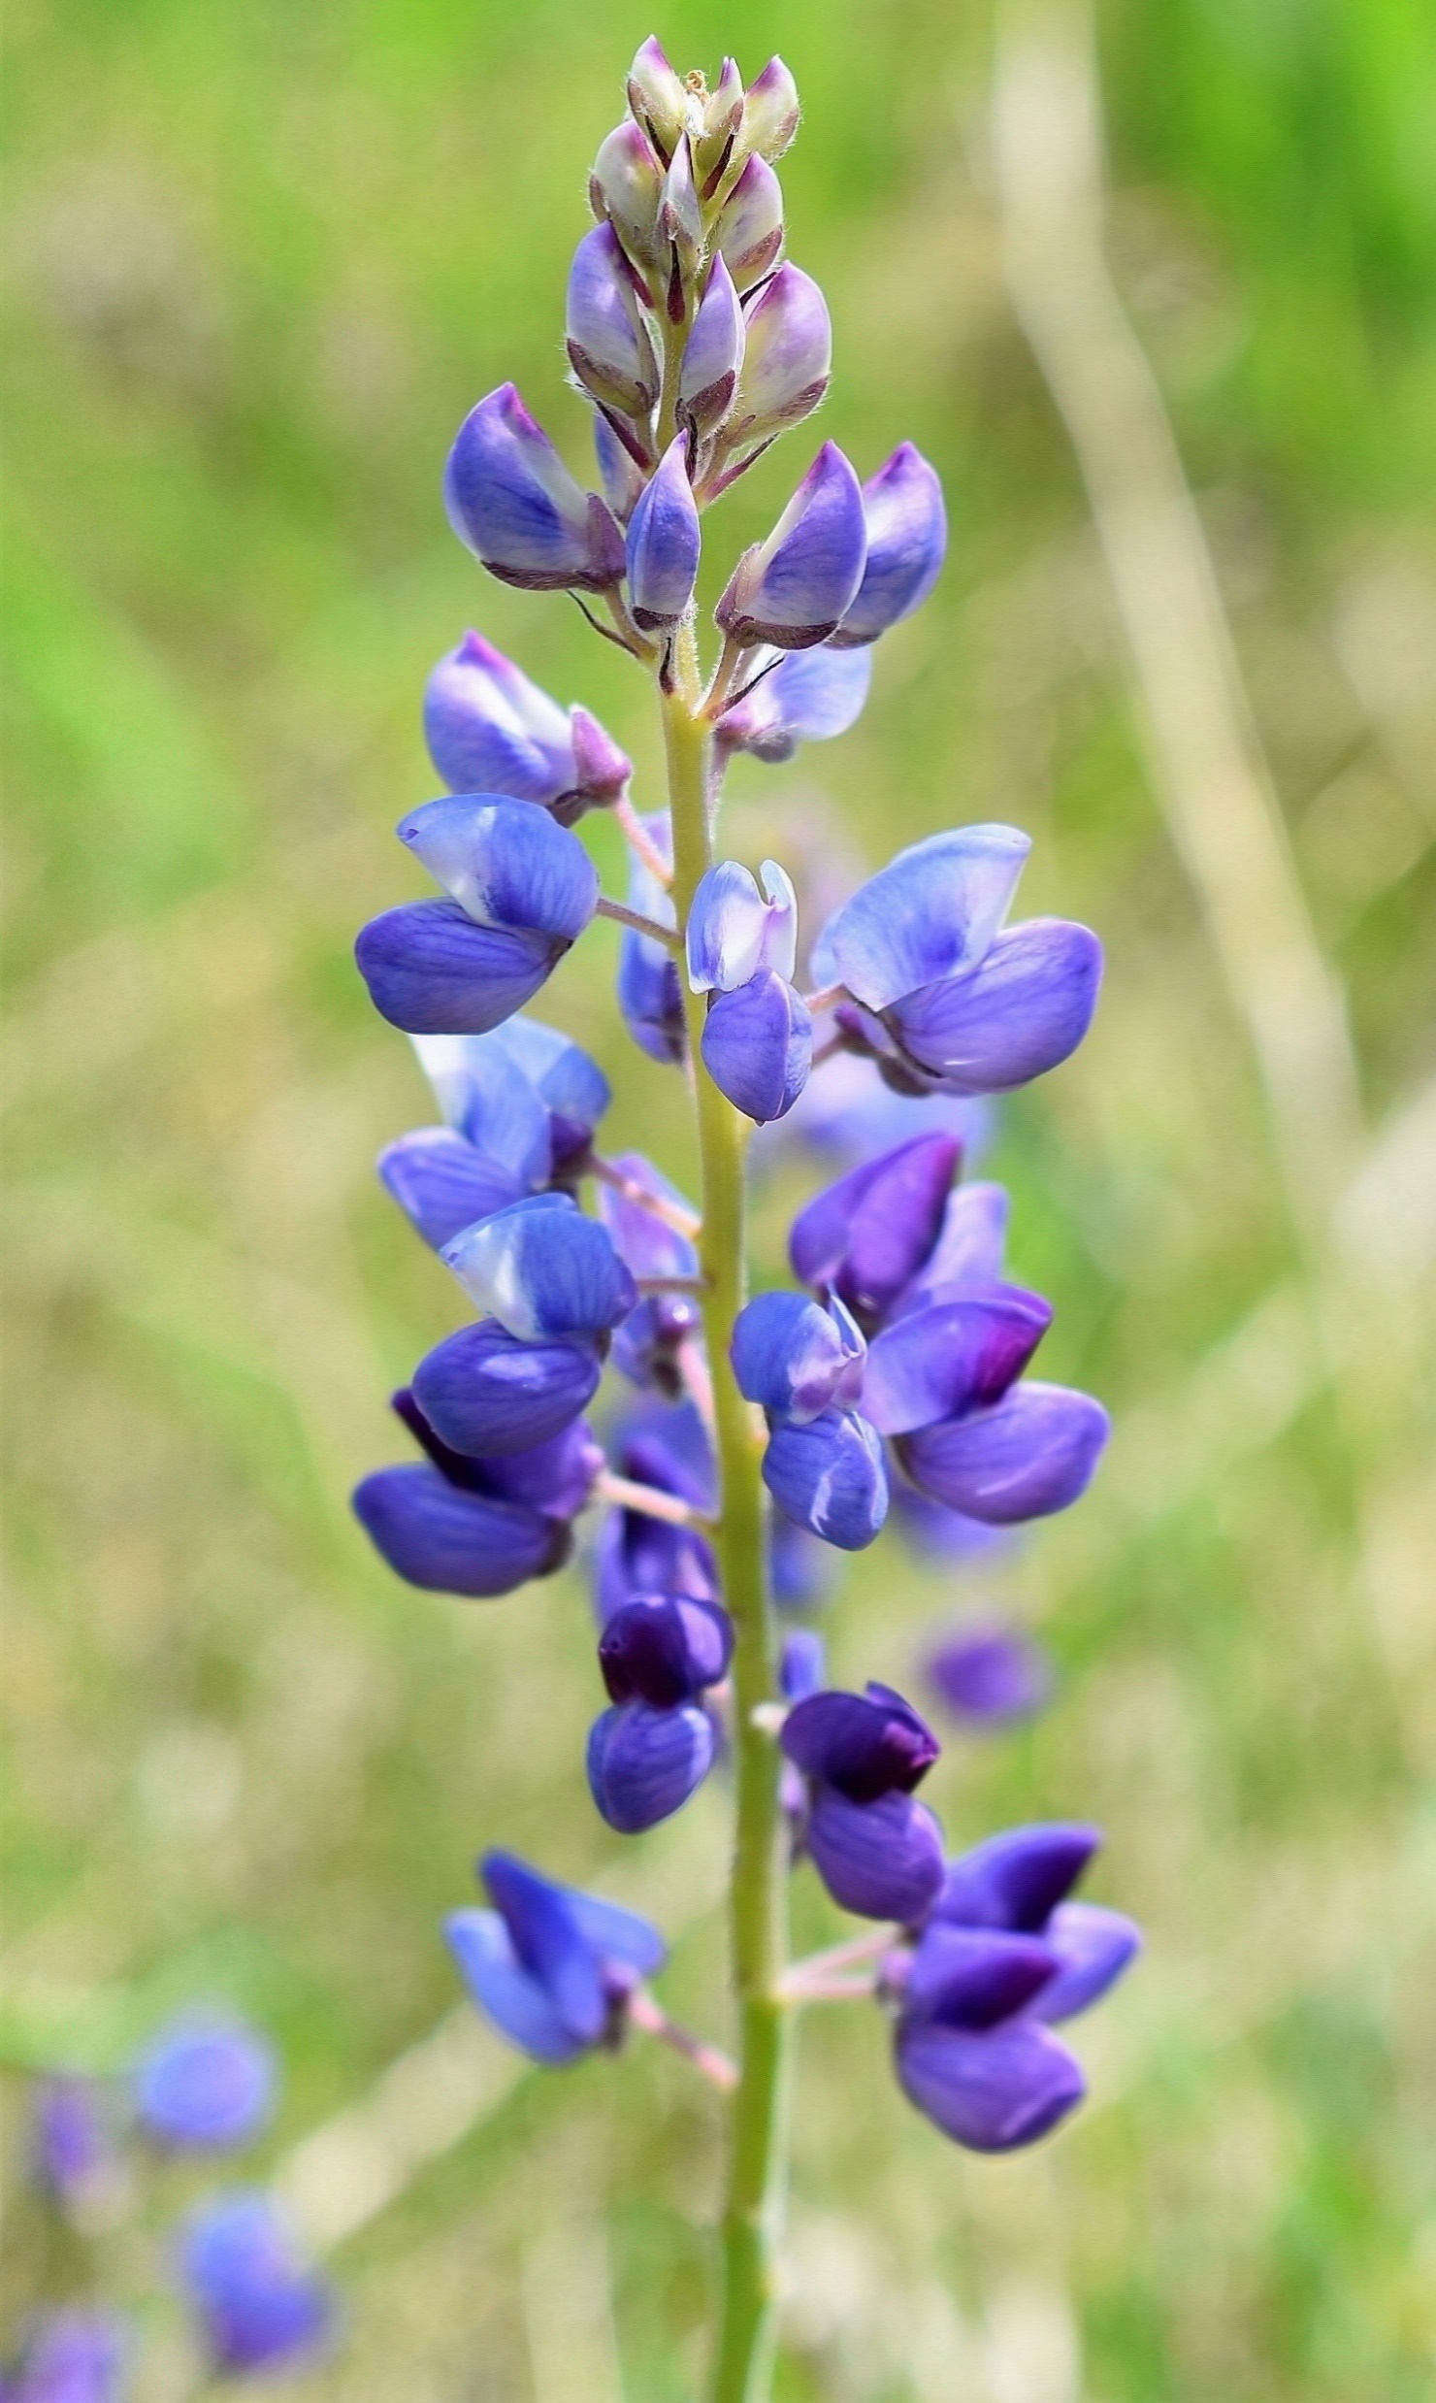
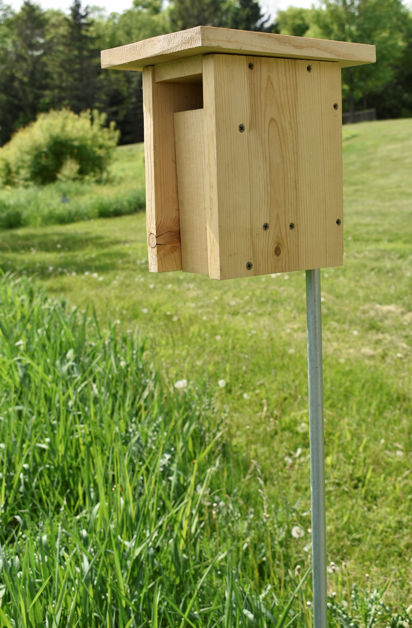
Activities (1)
There are a lot of things that I can do at Gammelgården Museum.
I can go on a museum tour of the five historic buildings if there is a tour happening while I am visiting.
I can explore the museum grounds which include a restored prairie and a bluebird trail.
I can look at the art exhibits, weaving loom, and/or participate in a class at Gammelgården.

Slide 14
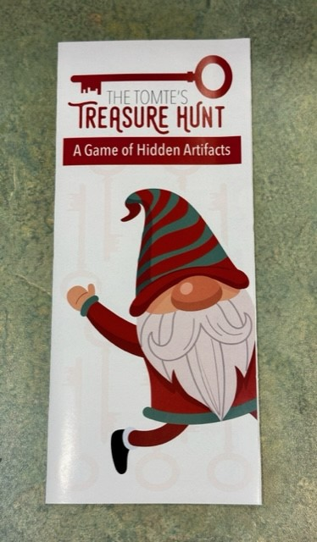
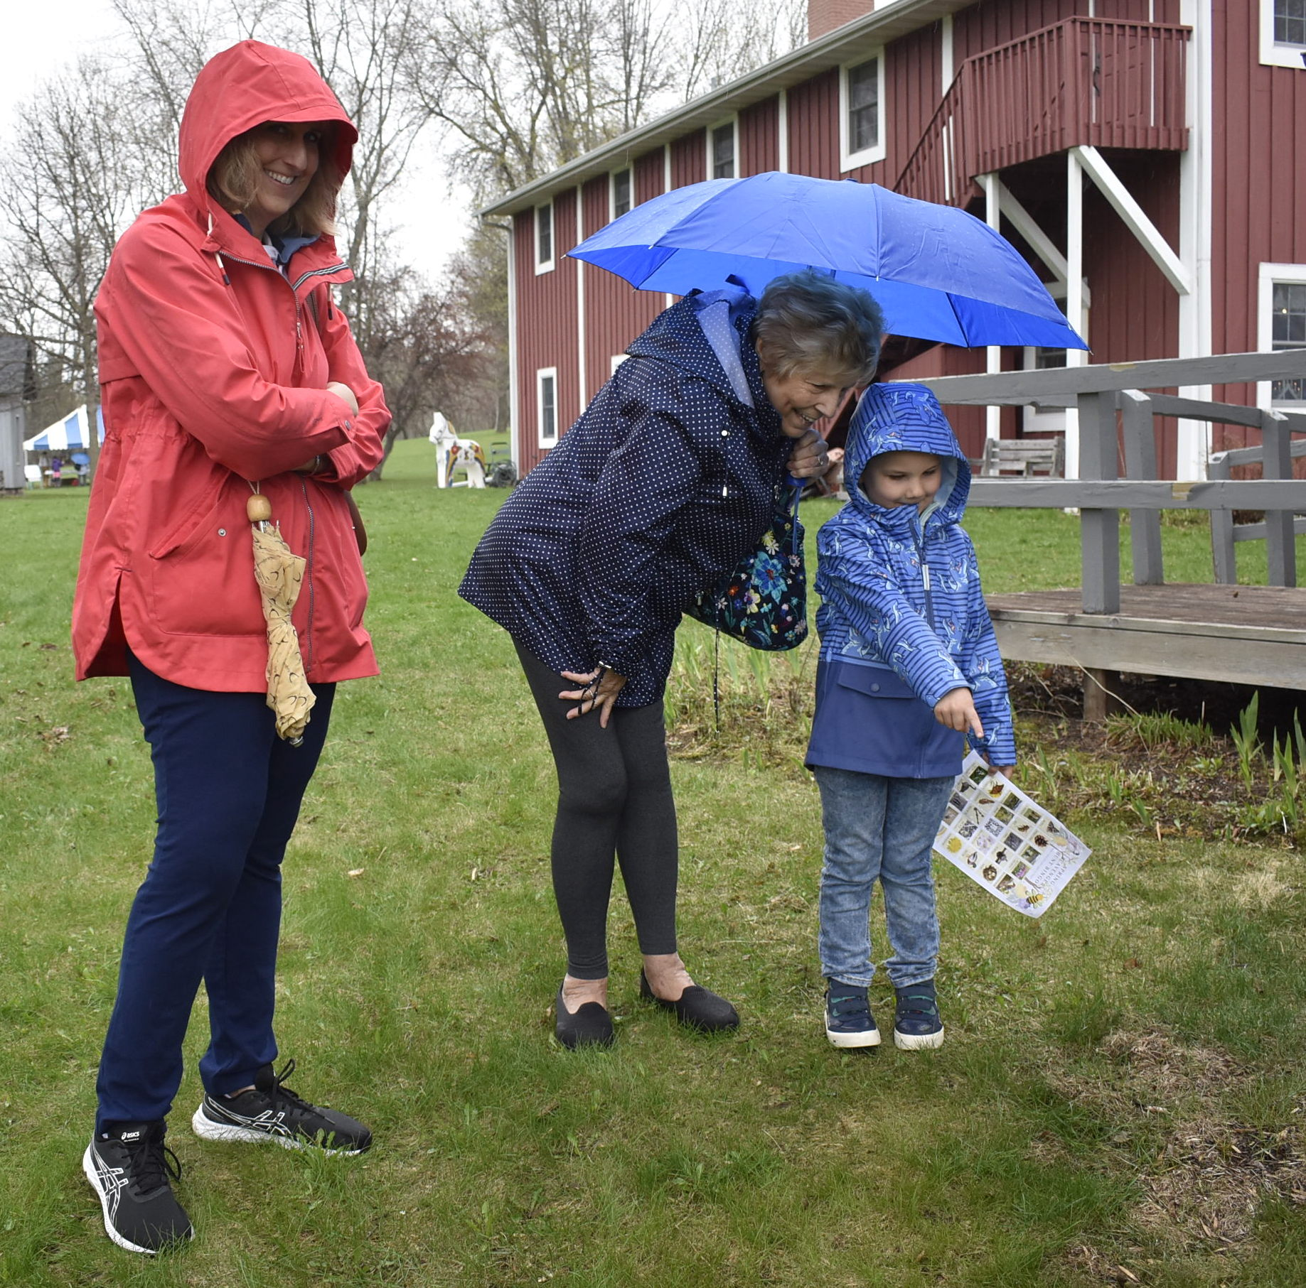
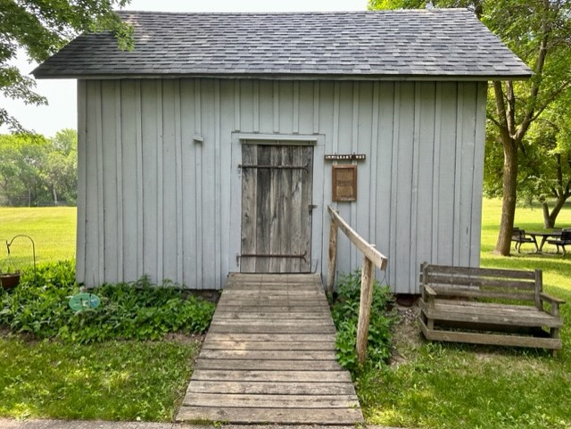
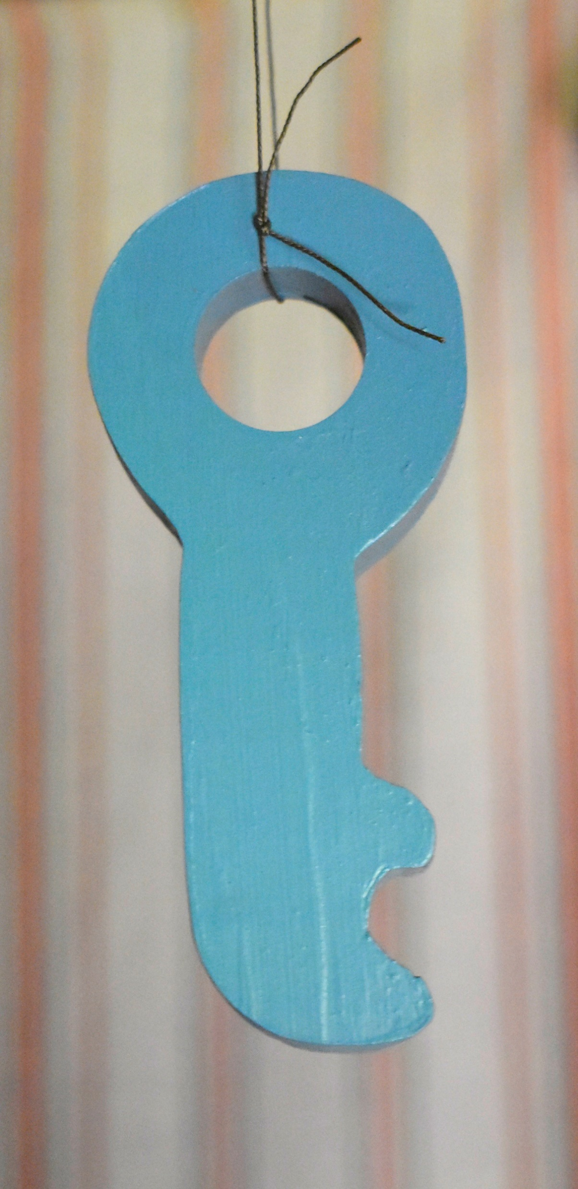
Activities (2)
There are two types of scavenger hunts that I can participate in: The Tomte’s Treasure Hunt and Seasonal Scavenger Hunts. For more information, I can visit https://gammelgardenmuseum.org/education-programs/#events-for-youth
If I do a scavenger hunt while the museum is open, I can go to the welcome desk in the big red building to receive a free coloring book.
I may see small wooden blue keys in each of the historic buildings. These are for identifying artifacts for those participating in The Tomte’s Treasure Hunt.
If there is not a tour, I can spend time looking at the outside of each building and reading the sign near it. I also can visit the museum’s website for a virtual tour of each building by going to https://gammelgardenmuseum.org/virtual-tours/

Slide 15
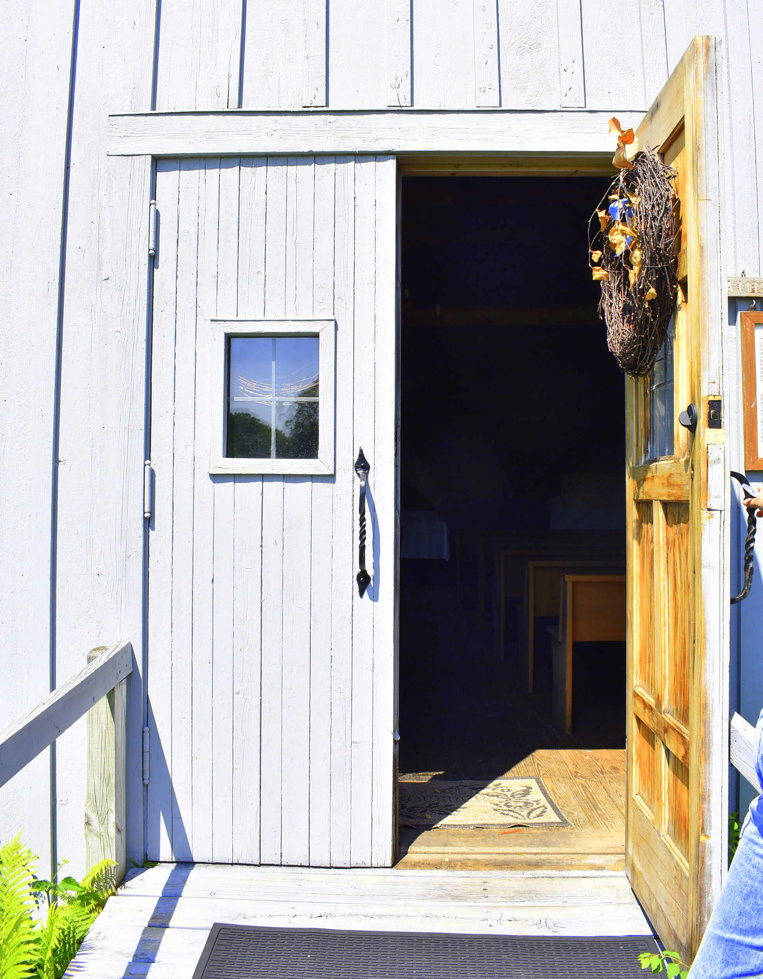
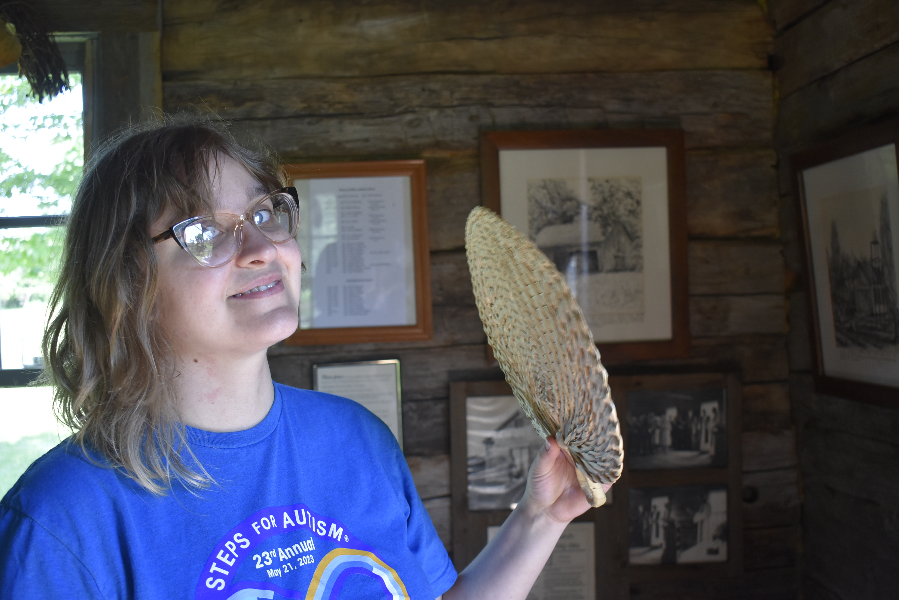
Old Church (Gammelkyrkan)
There are five historical buildings that I can see on my tour. I can see the Old Church, the Immigrant House, the Barn, the Pastor’s Home, and the Peasant’s Home.
These are historic buildings. The buildings do not have heating or air conditioning. I can dress in layers to help me stay warm or cool.
There is a lot of natural lighting on the tour. The buildings are old and have a natural wood fragrance.

Slide 16
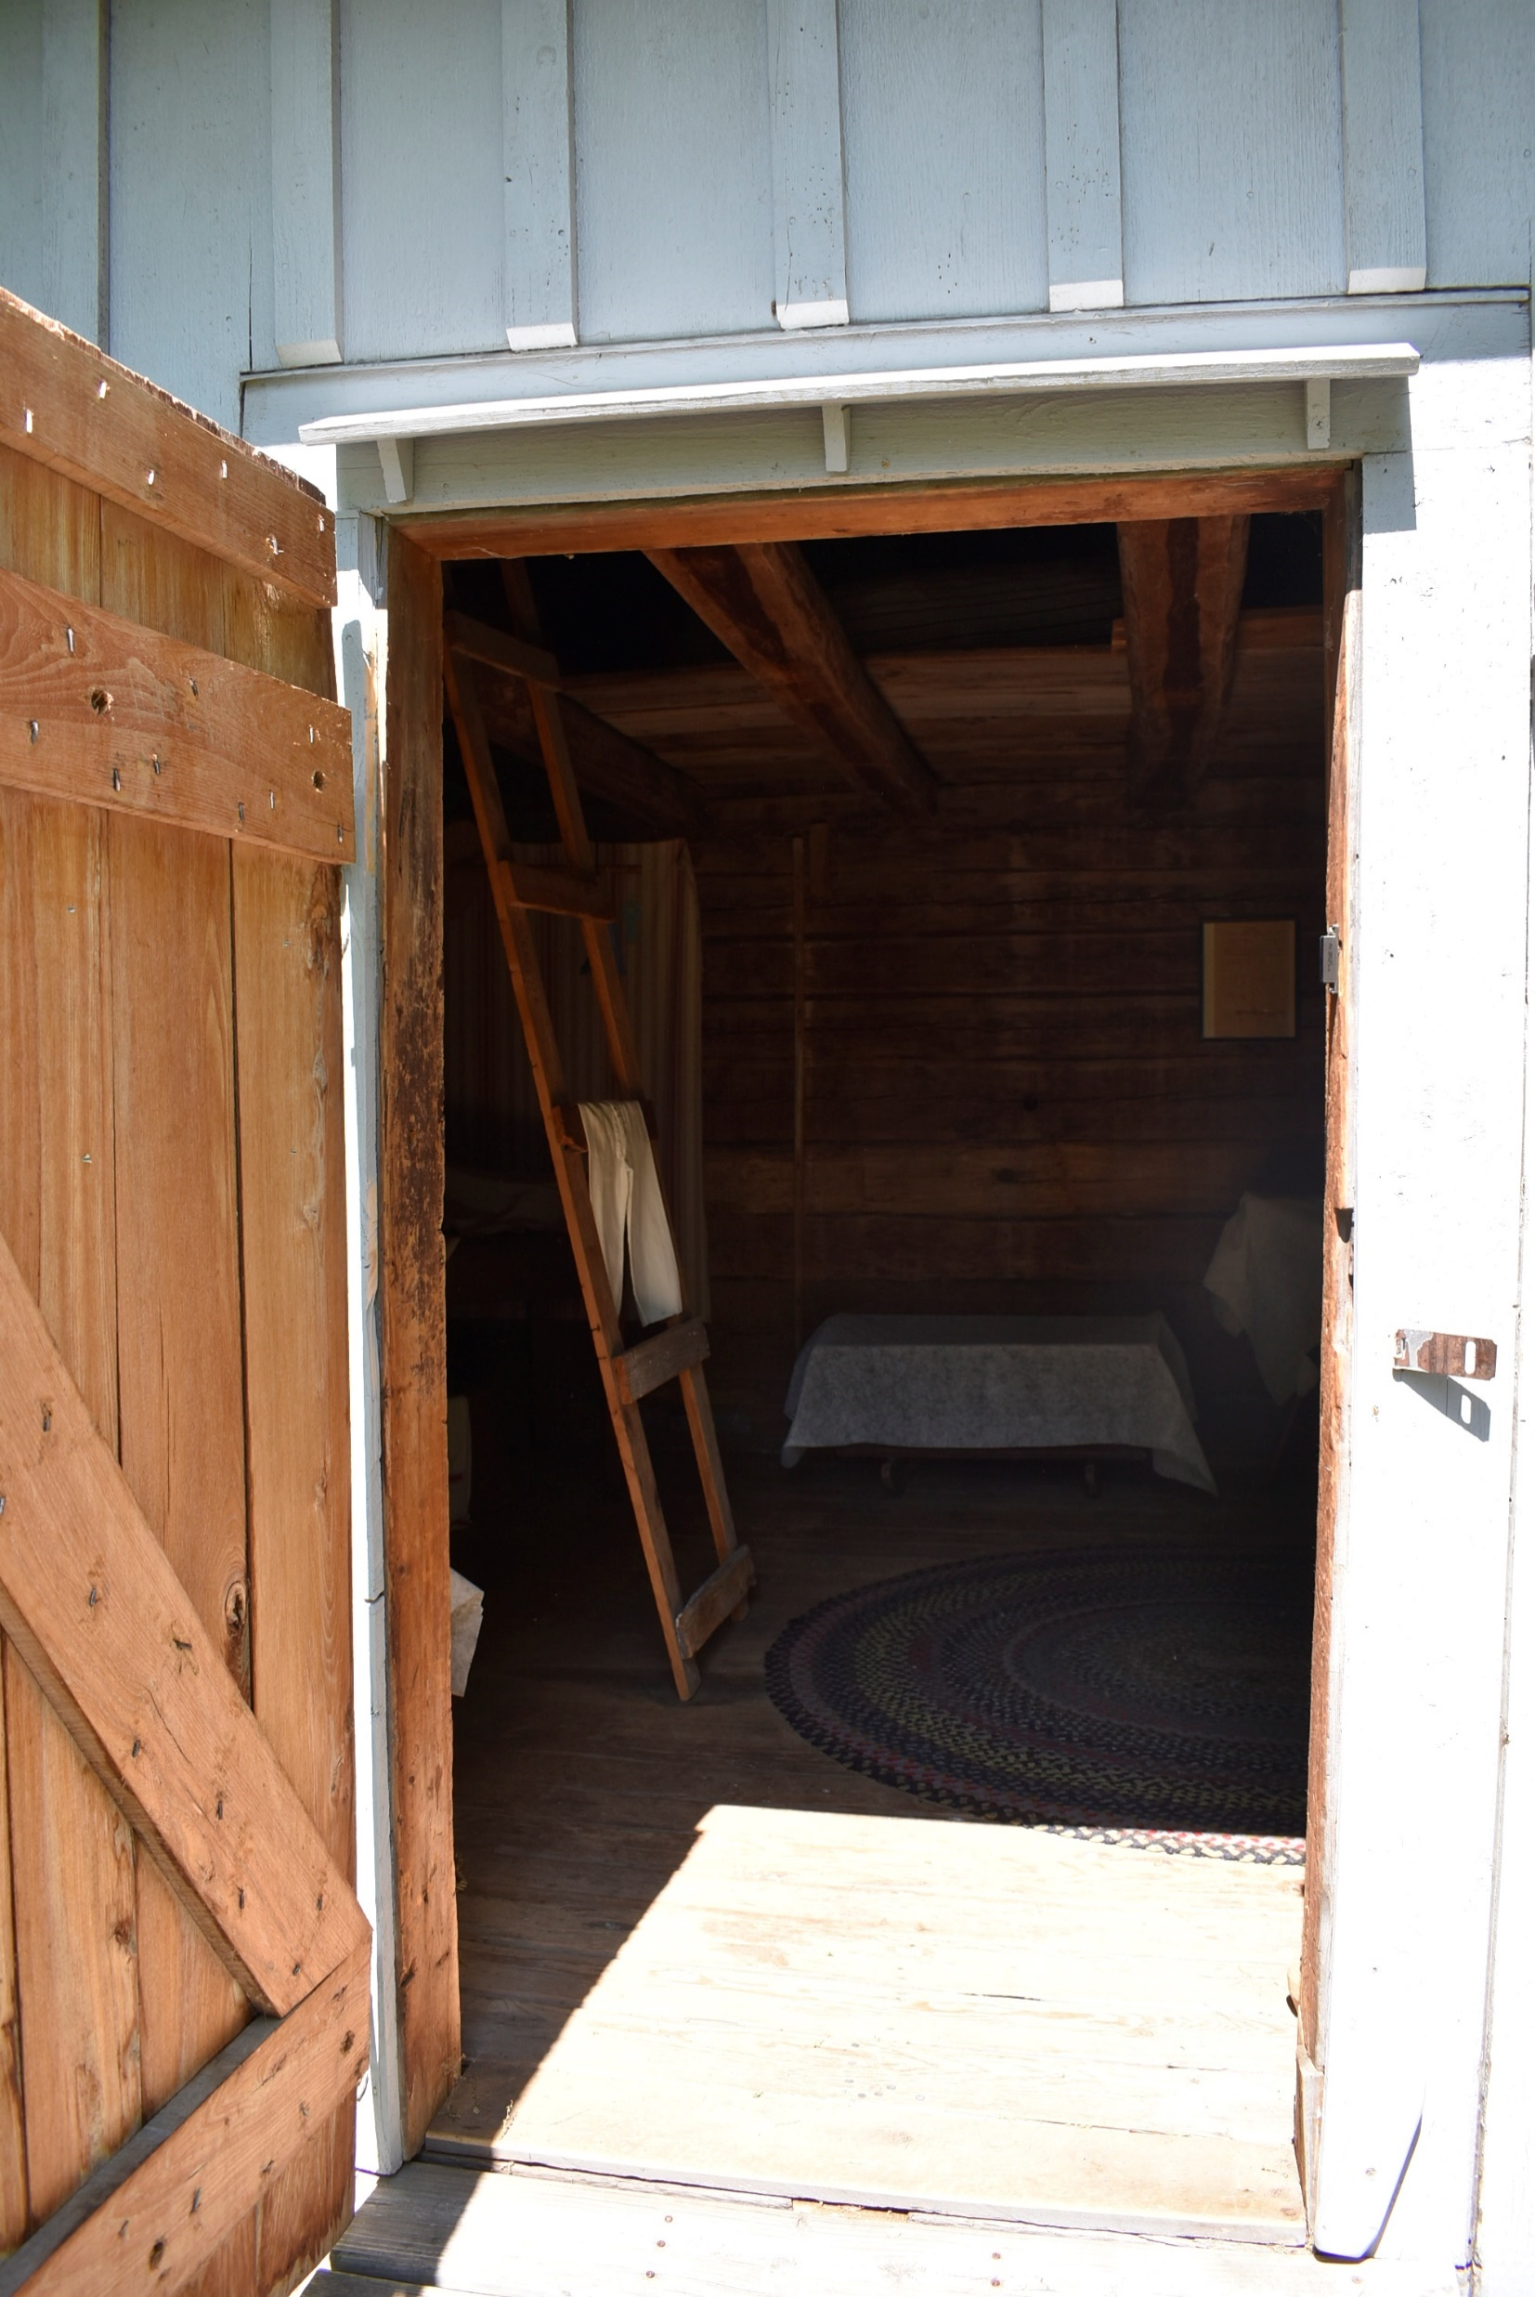
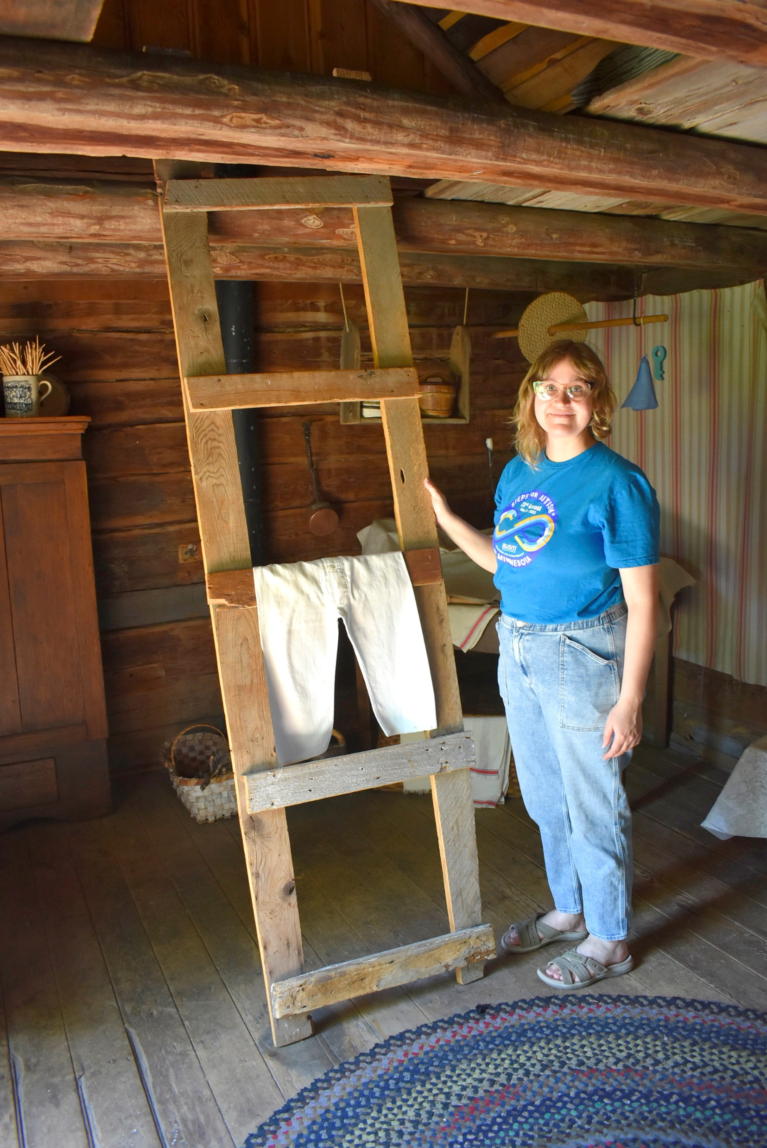
Immigrant House (Invandrar Hus)
Just like the Old Church, the Immigrant House has limited, natural lighting, and has the smell of an old, wooden building.
In the Immigrant House, there is a wooden ladder. It is for looking only and not for climbing. From the first floor, I can still see parts of the second level.

Slide 17
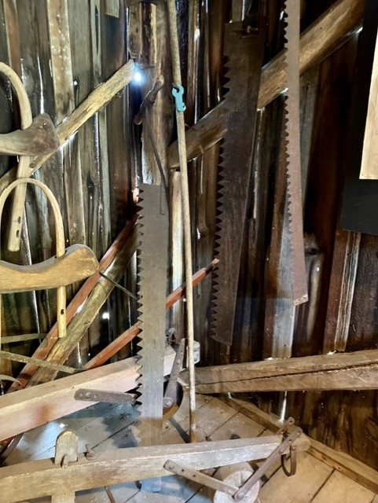
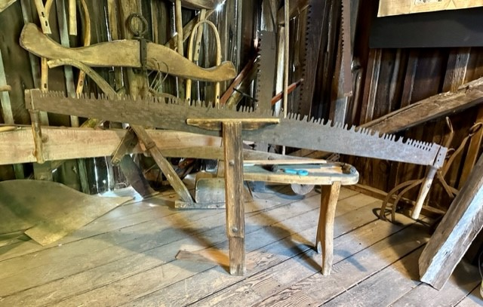
Barn (Ladugården)
There are many sharp tools in the Barn. The tour guide is the only person who can touch them.

Slide 18
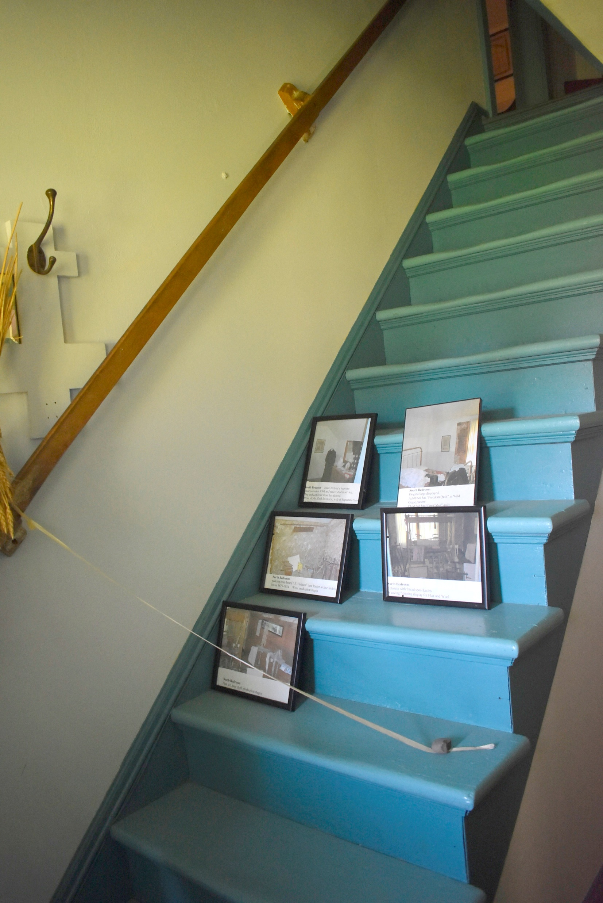
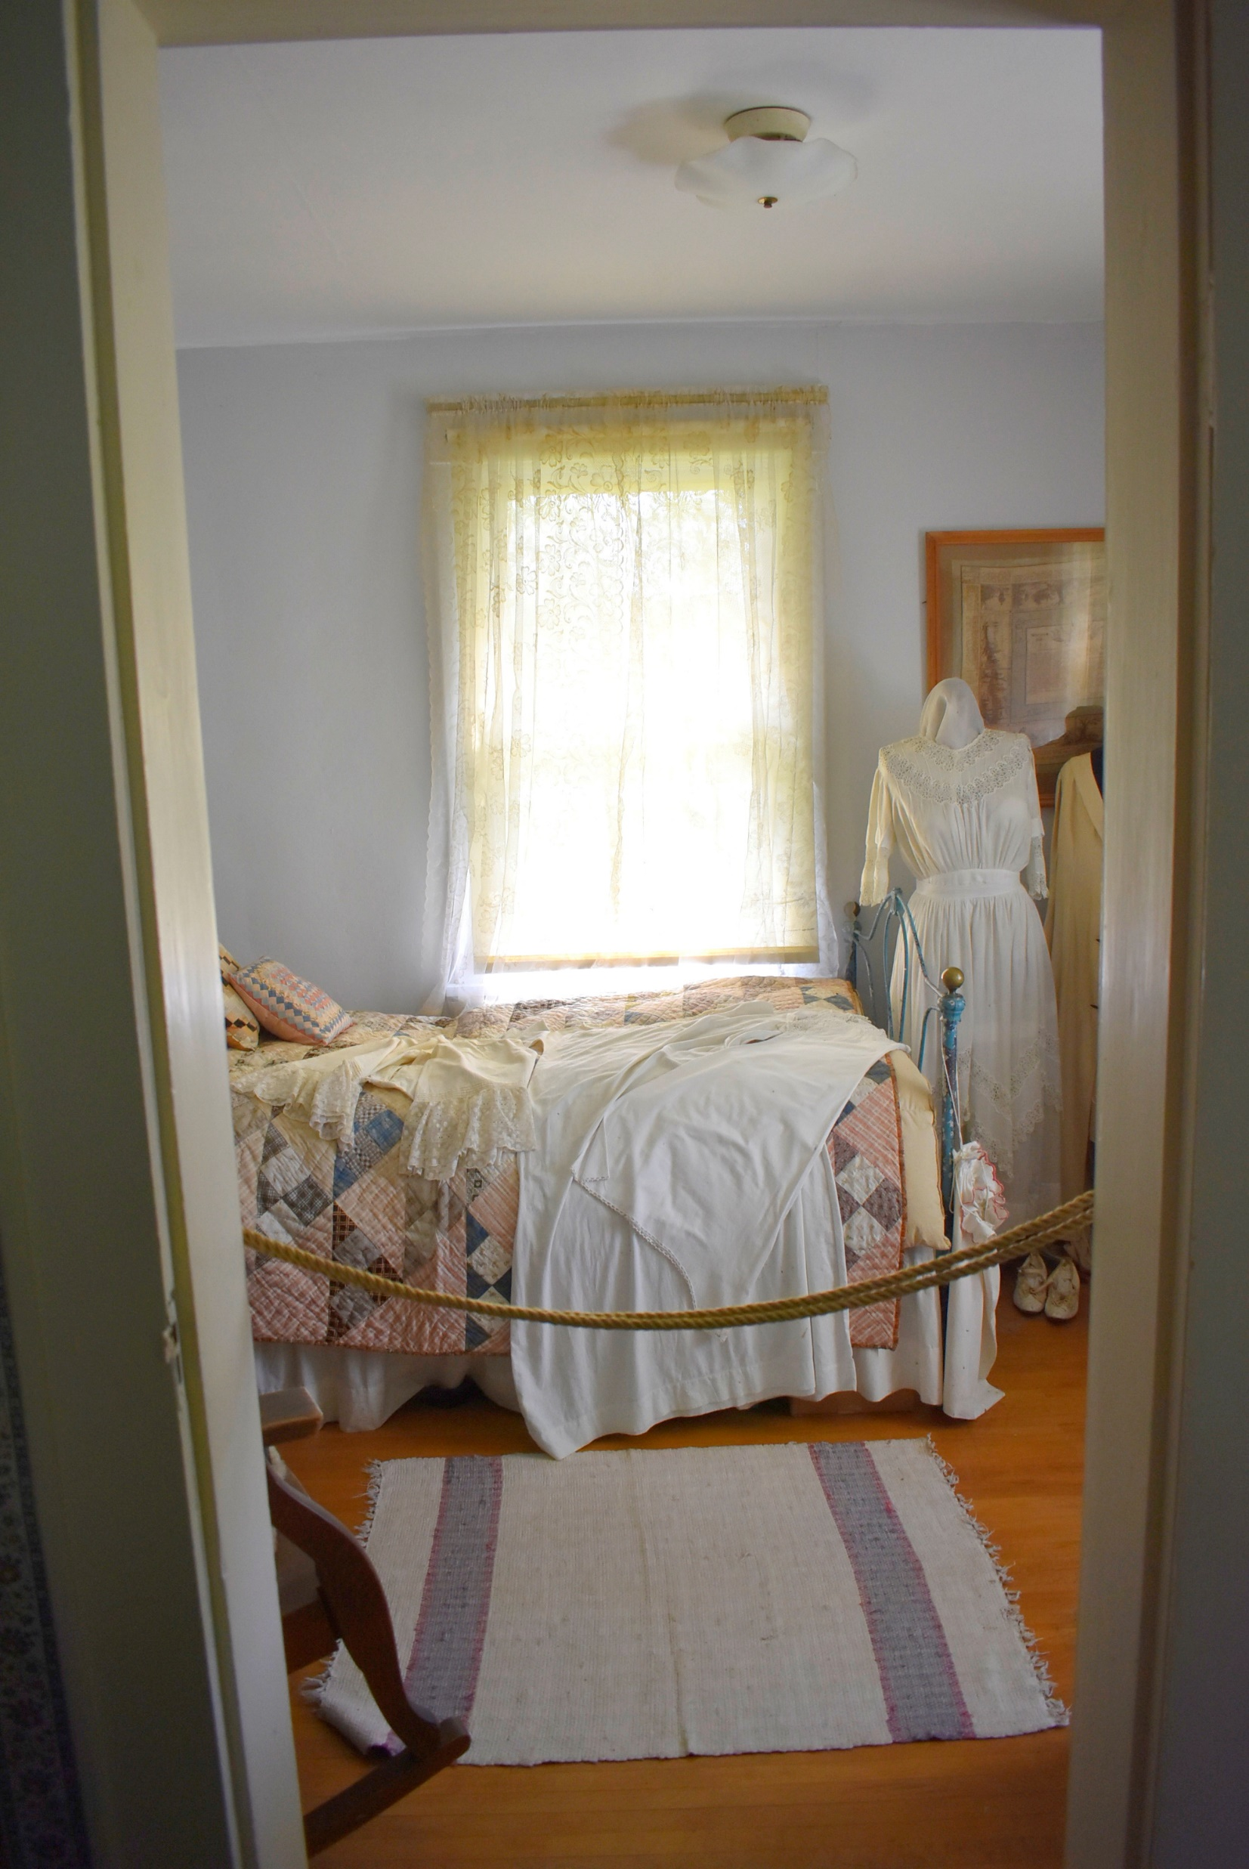
Pastor’s Home (Prӓstgård)
In the Pastor’s Home, there are “Do Not Enter” areas. These areas are marked by a ribbon. I do not move the ribbon or go into those areas. I also look at the furniture and do not sit on it.

Slide 19
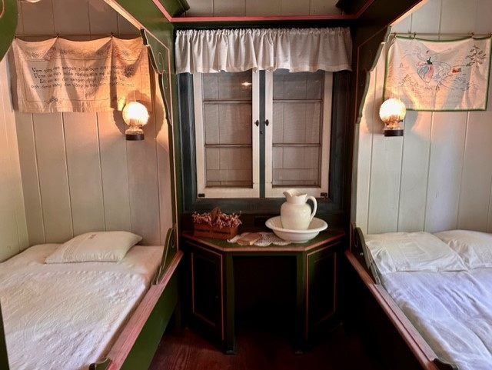
Peasant Home (Stuga)
In some of the historic buildings, there is furniture. Some of furniture may have ribbons across them and others may not. I do not sit or lay on the beds in the Stuga.

Slide 20
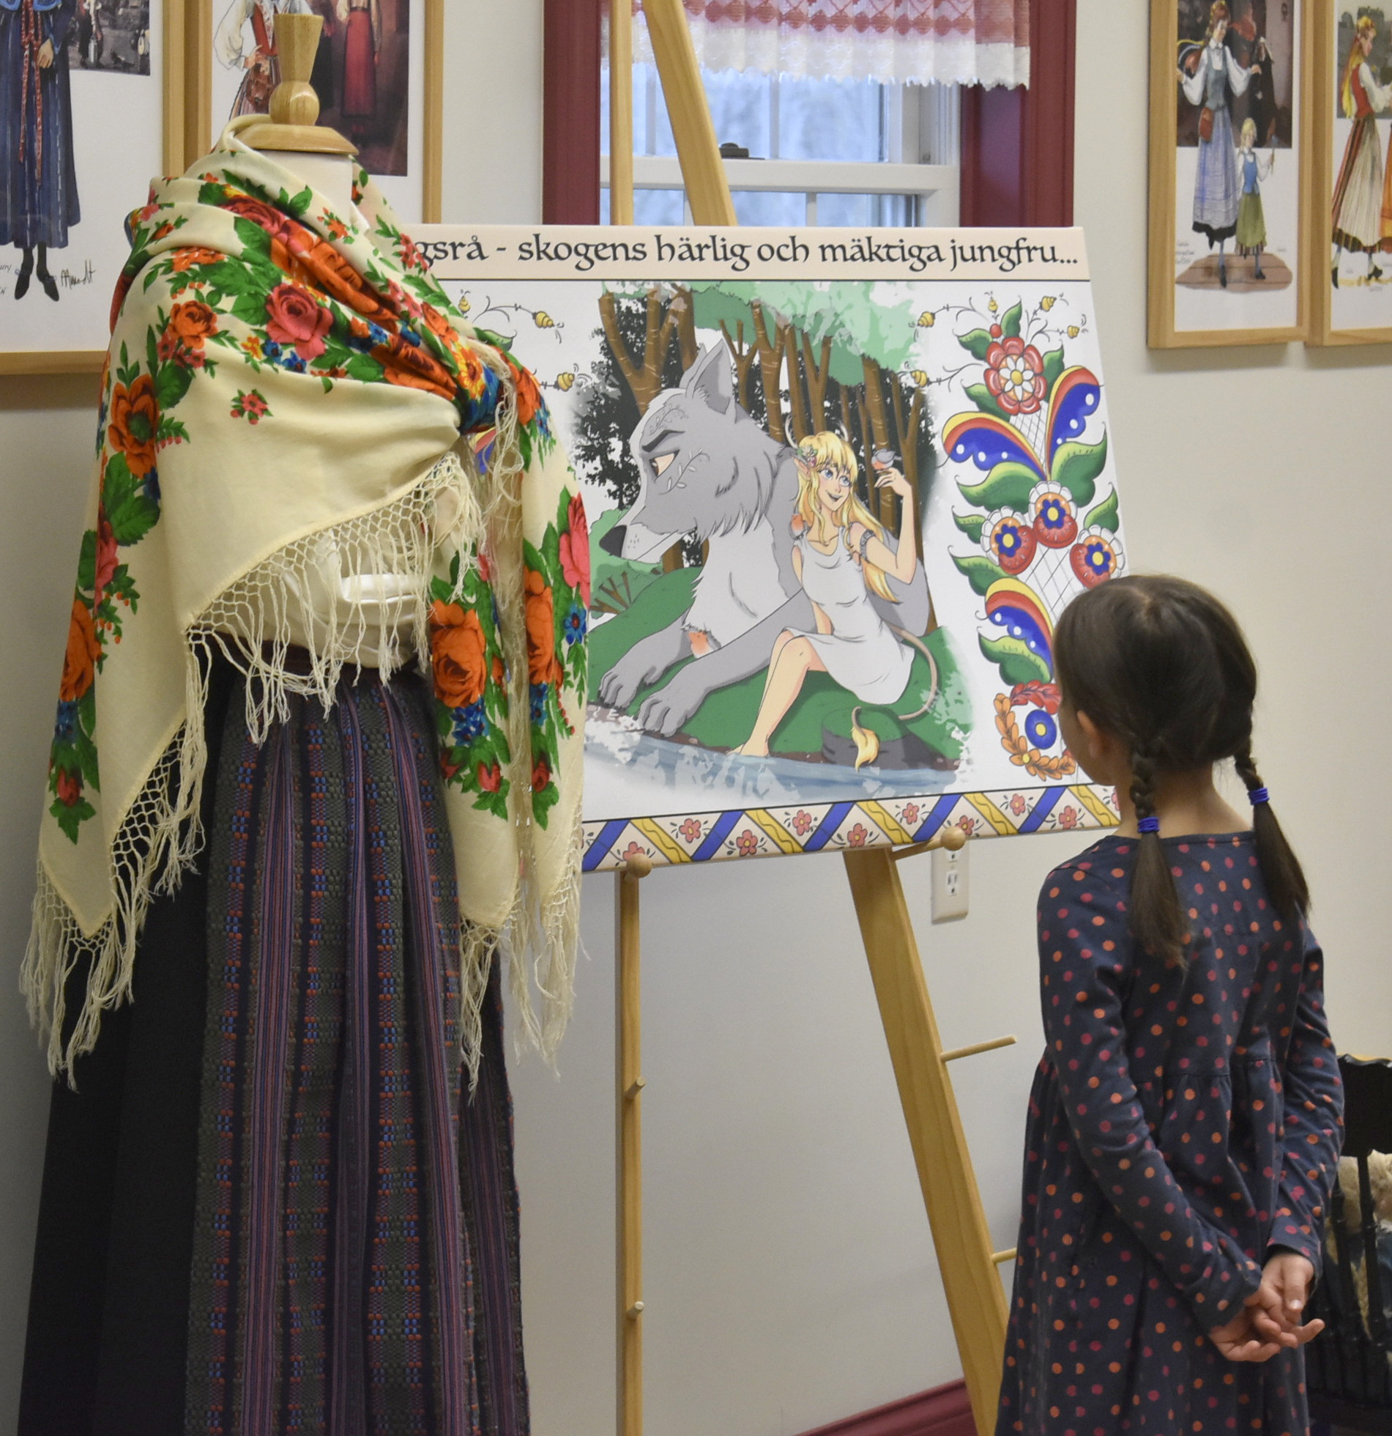
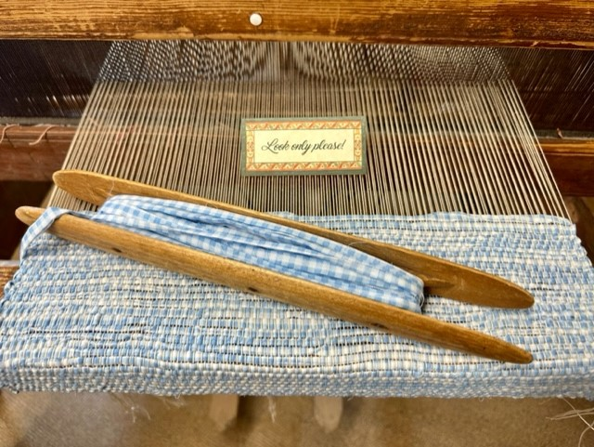
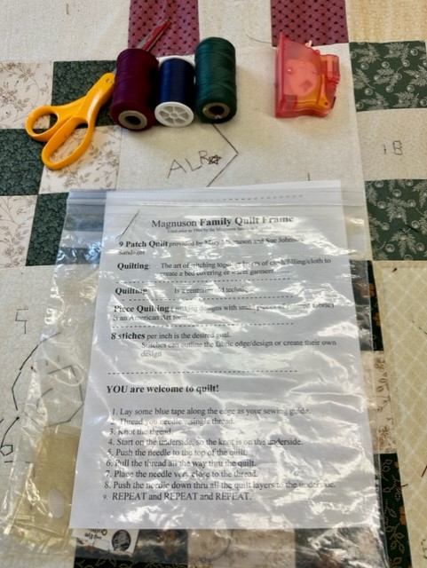
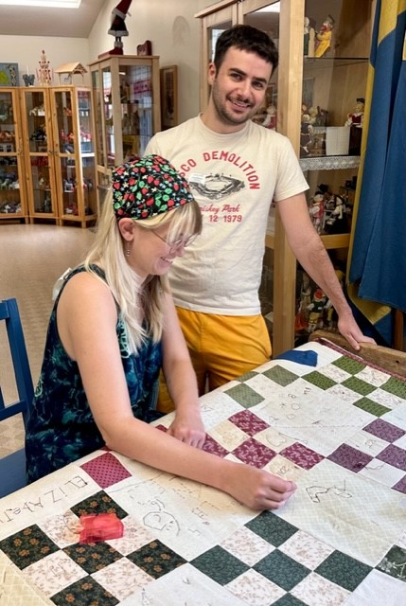
Welcome House (Välkommen Hus)
While at Gammelgården Museum I can spend some time on the second floor of the Welcome House seeing the art exhibit and displays, stitching on the quilt, and looking at the weaving loom.
When I look at the exhibits and weaving loom, I look only and do not touch any of the art or artifacts.
If there are items I can touch, there is a sign letting me know that I can touch them.
During these activities, I might experience issues related to light sensitivity because there are fluorescent lights on the second floor. I can leave the room or put on sunglasses if the lights are bothering me.

Slide 21
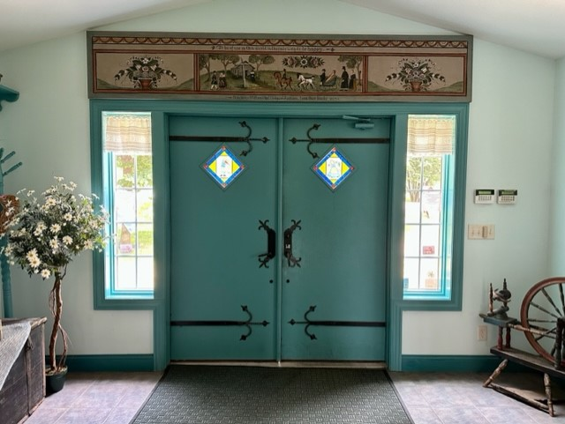
Departure
When the event or my time at Gammelgården is over, I can pack up everything I brought, bring it with me, and exit the building.
If I borrowed a sensory tool from the museum, I return it to a staff member before I leave.
If I need support finding the exit, I can ask a staff member or volunteer for help.

Slide 22
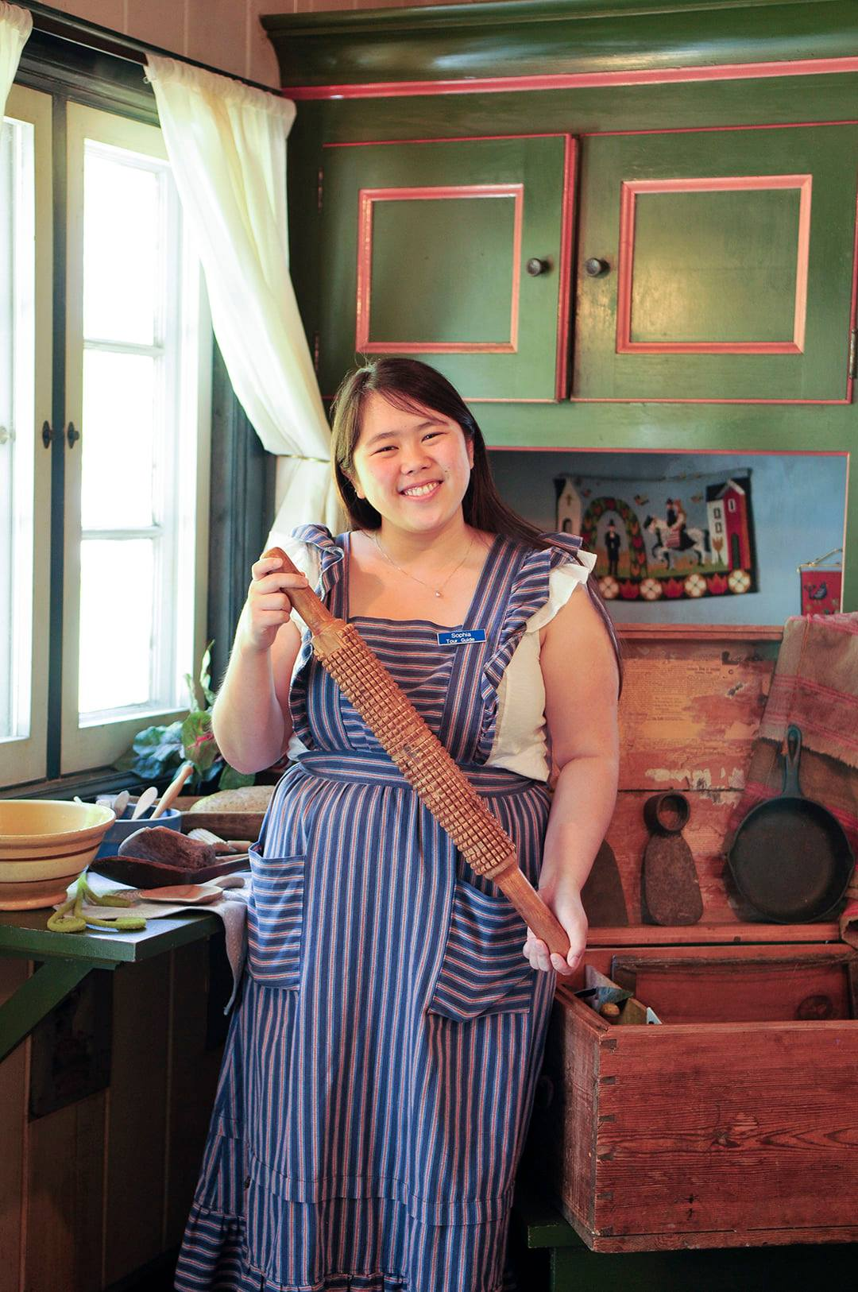
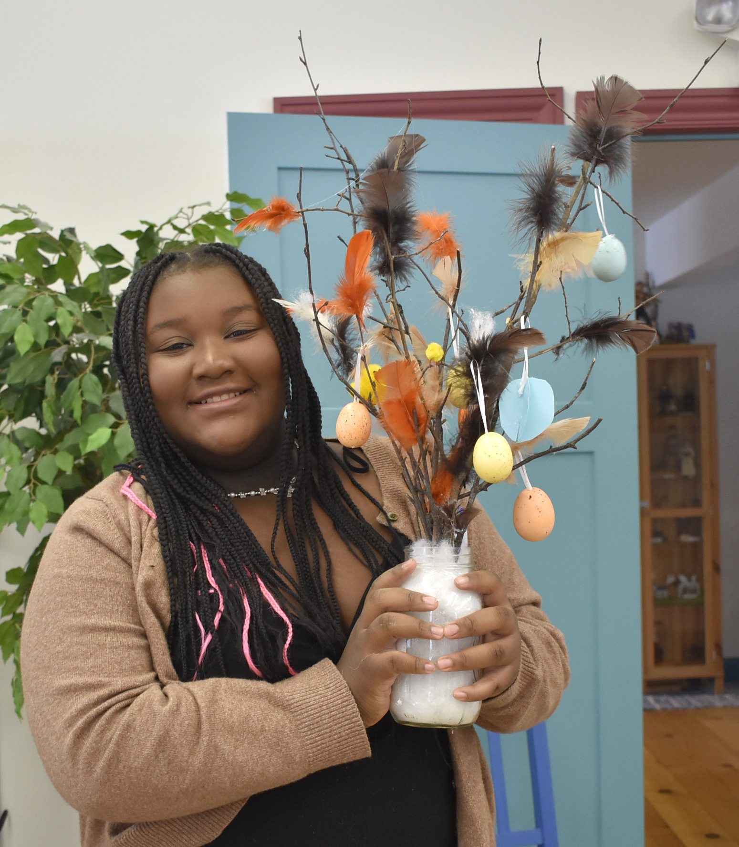
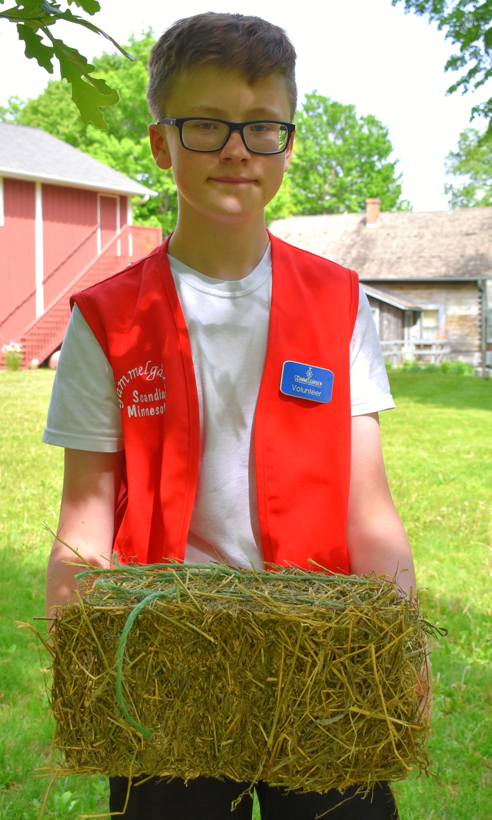
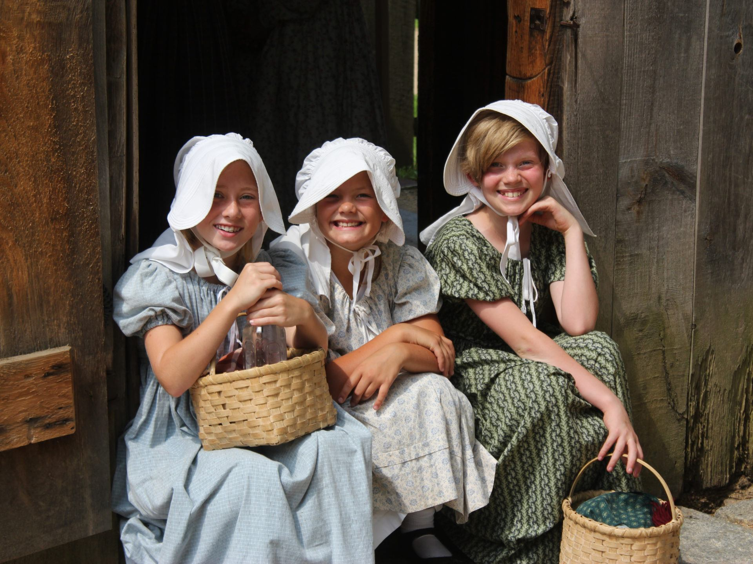
Thank you for coming!

