Slide 1
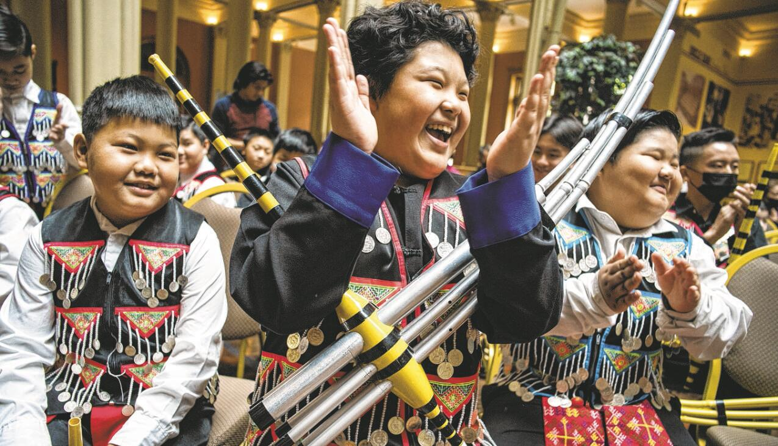
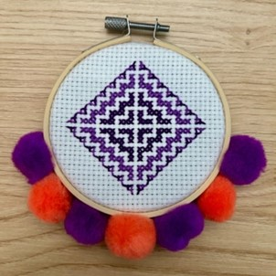
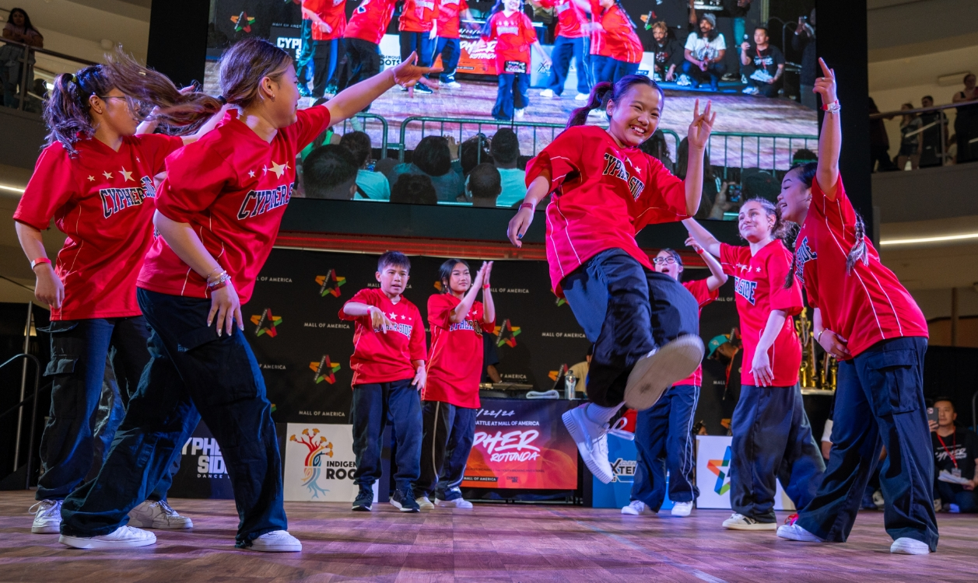
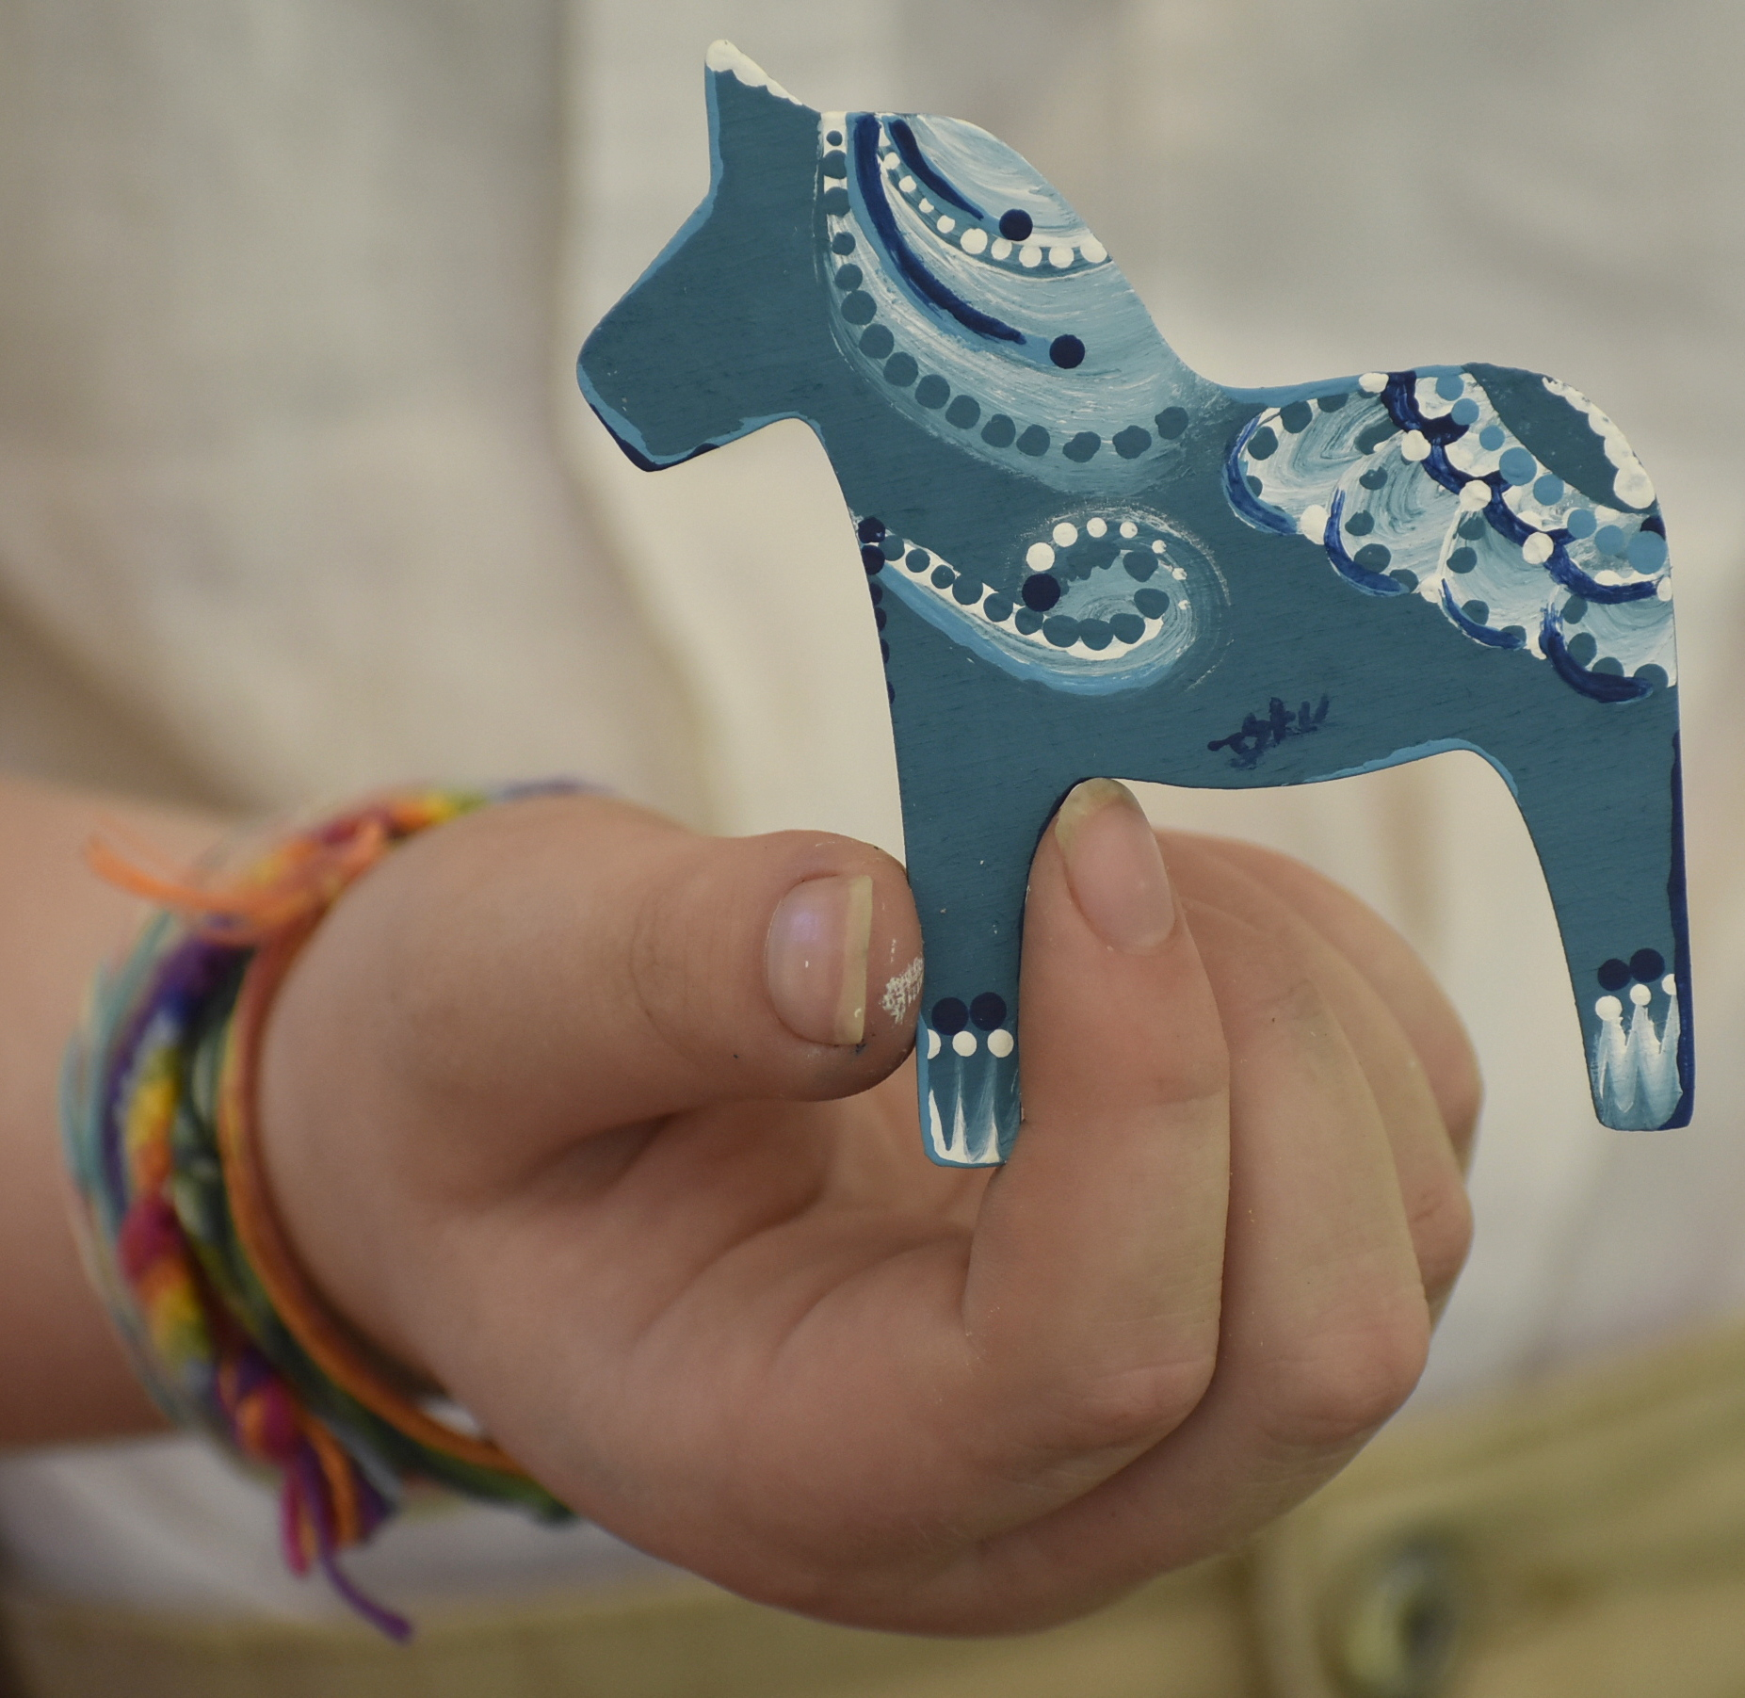
A free Music and Heritage
Event for the Entire Family
Saturday, August 17, 2024 10 am – 4 pm
Gammelgården Museum of Scandia
20880 Olinda Trail North, Scandia, Minnesota
Swedish and Hmong Folk Music and Dance | Children’s Crafts, Activities, and Games | Hmong and Swedish Presentations
Historic Building Tours | Artists, Crafters, and Vendors Fair | Food, Coffee, Cold Beverages, and Ice Cream
Family Activities 10:00 – 4:00
Historic Building Tours – Docents in Buildings(10-4). Tours for those who are Hearing Impaired (with headphones) or Deaf (ASL interpreter) – Meet at the Reception Desk at the Welcome House
Children’s Agricultural and Historical Activities: Learn to milk a cow, wash clothes with a washboard, make a hay bale, and weave – Historic Buildings
Do Hmong-Inspired and Swedish-Inspired Crafts – Welcome House
Outdoor Games – Museum Grounds
Artists, Crafters, and Vendors Fair – Museum Grounds
Paint a Dala Horse Activity for All Ages – Museum Grounds
Do a Scavenger Hunt and Get a Prize – Historic Buildings/Museum Grounds
Exhibits – See “Games, Toys, and Pastimes of the Mid- to Late-1800s,” “Tintype Photography,” “Wool Production,” “Dala Horses,” “Charlotte Weibull Dolls,” “What’s in Annie’s Kitchen?” and “Visit Norrbotten, Sweden” – Welcome House
Scandia Butik Gift Shop – Welcome House
Food For Sale 10:00 – 4:00
Eggroll Queen Food Truck – Eggrolls – Fried Rice – Beverages – Front Yard/Parking Lot
Union Hmong Kitchen – Chicken Meatballs Skewers – Laab – Taro Chips and Dip – Front of Welcome House
Gammelgården Museum – Loaded Meatball Sandwiches – Smörgåstårta – Swedish Pastries and Desserts – Kids Meals – Fresh Fruit Cups – Chips – Ice Cream Treats – Beverages – Coffee – Front of Welcome House
Cross-Cultural Art 10:00 – 12:00
Greeting Card: Create an Älvans Hus Fairy House greeting card with Marie Olofsdotter, a Swedish-born artist and poet –– Welcome House
Flower Cloth: Make a Hmong Paj Ntaub (3” cross-stitch design decorated with colorful pom poms) with Hmong artist Padah Vang, $9 cost; pre-register at: tinyurl.com/pajntaub24 –– Welcome House
Embroidery Comparison – Marlin Heise from the Hmong Archives and Natalie Norman display examples of Hmong and Swedish embroidery. See Hmong purses, handbags, shoulder bags, and embroidered paj ntaub and Swedish kjolväskor –– Welcome House
Parade of Performers 12:00
See musicians and dancers in traditional clothes in the parade – Through Museum Grounds
Barn Stage 11:00 – 3:30
11:00 – Senator Foung Hawj – Hear about similarities between the
immigration experience of early Swedish immigrants to Minnesota in the 1800s and Hmong immigrants to Minnesota, primarily after the 1980s. Hear about how Swede Hollow in St. Paul was and is an initial entry point for many immigrants, including Swedish and Hmong.
12:05 – Parade of Performers Arrives at the Stage – Group introductions and Allspel (all groups play)
12:10-3:00 – During short breaks between performances, be entertained by Emcee/Comedian “Ole” Impersonator, Bruce Danielson.
12:20 – ASI Spelmanslag
1:00 – Cypher Side Dance Studio
1:30 – Hardingfelelag, Hardanger Fiddle Group
2:10 – Hmong Cultural Center’s Qeej Group
2:40 – Hejmakers - Renee Vaughan and Tom Klein
3:00 – Ross Sutter
3:20 – Hmong Cultural Center’s Qeej/Nordic Collaborative Piece
3:30 – Closing Allspel and Hälsa Dem Därhemma led by Ross Sutter
Old Church Stage 12:20 – 3:30
12:20 – Instrument Petting Zoo – See and touch instruments up close,
and ask questions about how they are played. Explore the nyckelharpa, qeej, pump organ, hardingfele, pipes, cittern, accordion, violin, and guitar.
1:20 – Hejmakers - Renee Vaughan and Tom Klein
1:40 – Ross Sutter
2:00 – Paul Dahlin and Friends
2:20 – Open Mic
2:30 – Lilla Spelmanslag
2:50 – Open Mic
ASL Interpreters and Hearing-Assisted Listening Devices Available
This event is made possible by the generous support of The American-Scandinavian Foundation,
Valley Arts Initiative - St. Croix Valley Foundation, Scandia-Marine Lions Club,
Twin Cities Nyckelharpalag, and Gammelgården Museum of Scandia donors.
651-433-5053 gammelgardenmuseum.org instagram.com/gammelgarden_museum_of_scandia

